Slide 1
January 9, 2026
Survey of Likely 2026 General Election Voters
National
January 7 – 8, 2026 | n=1500 | ±2.51%

Slide 2

Insights & Analysis
50% of voters support (46% oppose) Trump’s U.S. military operations to arrest and charge Venezuelan President Nicolás Maduro, and support is stronger among less frequent and newer voters. 15% of Democrats agree with the actions.
However, voters oppose (54%) the U.S. running the country (41% support). The goal of what to accomplish is partisan:
GOP – 50% establish a stable government, 6% avoid military involvement at all
IND – 37% establish a stable government, 41% avoid military involvement at all
DEM – 19% establish a stable government, 60% avoid military involvement at all
Since the raid, Maduro’s image has gone from 40% unfavorable to 69% unfavorable.
Sticking with the theme of weapons…59% of Democrats believe the federal government has been weaponized against liberals/Democrats. 49% of Republicans believe it’s been weaponized against conservatives/GOP. Independents see it more down the middle: 34% against both side, 33% against Dems, and only 16% against the GOP.
73% of voters believe they very or somewhat often encounter misinformation. Democrats believe this less, including 28% of them who don’t encounter misinformation much at all.
A greater problem for our country is that 88% believe we’re living in an era where America can’t agree on basic facts. Younger voters are more likely to strongly agree with this statement by a 9-point margin above voters over 55.
There is a competitive but movable electorate. Democrats lead the generic congressional ballot 48% - 45%, a D+3 edge that has been fairly stable since late 2025.

Slide 3
Insights & Analysis
However, unfavorables for Democrats in Congress (57%; -10 net fav since November 2025 and -20 net unfav total) are higher than for Republicans in Congress (54%; +2 net fav since last month but -12 net unfav total).
The shift against Democrats in Congress is mainly being driven by college-educated voters (-10 net fav), without any offsetting by non-college voters (no change).
Trump’s image has improved +6 net points since November and, once voters are informed of Trump’s economic and national security successes, 45% say they would have a more favorable opinion of him vs. just 17% less favorable.
10% of Harris voters say they have an improved image of Trump after hearing these successes.
When newer and lower-propensity voters hear about Trump’s successes, they become 5% more likely to be favorable of the President, showing the persuasion ability he has going into the midterms.
The national mood remains sour but has improved +9 net since November. “Wrong track” is 55% (improved from 59%), while “right direction” moved up from 37% to 42%.
Voters prefer divided government. A 51 – 42 preference for a divided Congress over unified GOP control suggests the need to pitch empathy, competence, accountability, and policy wins rather than single‑party dominance.
The most likely voters (3-of-4 and 4-of-4) are 3 points more likely now than they were last January to prefer a unified Congress to support President Trump’s agenda – a strong, positive signal for Republicans heading into the 2026 midterm elections .
The top priority landscape still centers on pocketbook stress: inflation & the economy (20%) leads, with threats to democracy (17%), healthcare (15%), and government spending/waste (14%) next.

Slide 4
Insights & Analysis
Inflation’s priority dropped from 25% in December (-5), but remains the #1 issue.
Healthcare has slowed it’s growth as the main concern while government spending and waste has jump +3 points since December.
It’s urban voters (-11 inflation), non-White voters (-9), and non-college voters (-7) who are driving the shift away from inflation and the cost of living as a top priority.
Urban voters drive most of the increase in threats to democracy as a top issue.
These same voters are 15 points more likely to say Trump’s immigration policies are making their communities less safe, and 60% say the deportations have gone too far.
Among those voting GOP on the generic ballot (45%), top priorities center on government spending & waste (25%), illegal immigration (25%), and inflation (17%).
The Democratic electorate (48%) prioritizes threats to democracy (31%), healthcare (23%), and inflation (21%).
Moderation in inflation priority, at least among non-TDS voters, reflects improved economic perceptions. 32% rate the U.S. economy as excellent or good (+3 since August 2025), though terrible + poor is still 41%.
Voters are 2 points more likely to rate their personal economy as excellent than they were in August – mostly driven by Republicans (+5), men (+3), and voters earning $125K+ (+6).
Even with slight easing, voters still want tangible relief. Framing around lower taxes and spending restraint connects. Economic priority shows cutting taxes (32%) leads reducing deficits (28%), which is far ahead of increasing investments (19%).

Slide 5
Insights & Analysis
Democratic voters (+8 unsure over topline) are 3x as perplexed about how Congress should fix the economy as Republicans – who know the answer is cutting taxes (39%) and reducing deficits (32%).
Economic confidence markers are weak: a 37% plurality are not at all confident in finding a comparable job within three months, and 30% say they’re not at all confident managing a $1,000 emergency. Mortgage rate relief is neutral (44% “makes no difference”), with more likely to buy a house at only 13%. 42% oppose future rate cuts if they knew if would cause inflation to increase.
There is a strong gender and income divide on ability to withstand an emergency expense. 37% of women are not at all confident, compared to just 22% of men (33% extremely confident).
Half of voters earning $125K or more are extremely confident vs. just 12% of working-class voters earning less than $75K (45% not confident).
National security is a bright spot for Republicans: Trump’s national security handling 50% approve / 46% disapprove – a +4 net positive approval rating.
Affordability/economy are underwater (-11 net disapprove), reinforcing the need to foreground competent affordability improvements.
Men over 55 (58% approve) and non-college men (56%) approve of Trump’s handling of the economy, but swing voters (56% disapprove) and non-college women (55%) disagree.
Capitalism: 54 fav, 30 unfav; down modestly vs. 57% favorable in July.
Socialism: 30 fav, 54 unfav; essentially flat vs. 31% in July.

Slide 6
Insights & Analysis
The gap remains wide (+24 net for capitalism vs. -24 net for socialism), but capitalism’s intensity shifted slightly from “somewhat” to “very” among older/conservative blocs, even as younger voters widened their pro‑socialism lean.
On deportations, Americans are divided, but it’s important to note this survey started fielding on the day of a deadly ICE-involved shooting in Minnesota. Going too far 50%, about right 25%, not far enough 22%.
Perceived community safety from immigration policies is +6 net that Trump’s policies have made communities safe. Housing market affordability impact is mixed; 36% say no impact. The body politic wants order with limits – room for a firm but fair Republican posture.
Voters picking the Republican on the generic ballot are split between about right (46%) and not far enough (43%), while Democrats are 87% “going too far.” Swing voters say going too far by a 21-point margin.
Half of women under 55 and college-educated women – the same two groups Cygnal identified in October as being most likely to believe political violence against ICE is acceptable – believe Trump’s immigration policies are making their communities less safe.
61% of liberal White women age 18-44 believe violence against ICE is acceptable (Oct 2025 data).
Preferred type of Republican: moderate (32%) leads Trump‑aligned (21%) and traditional conservative (20%). 45% of swing voters want a moderate Republican who works across the aisle.

Slide 7
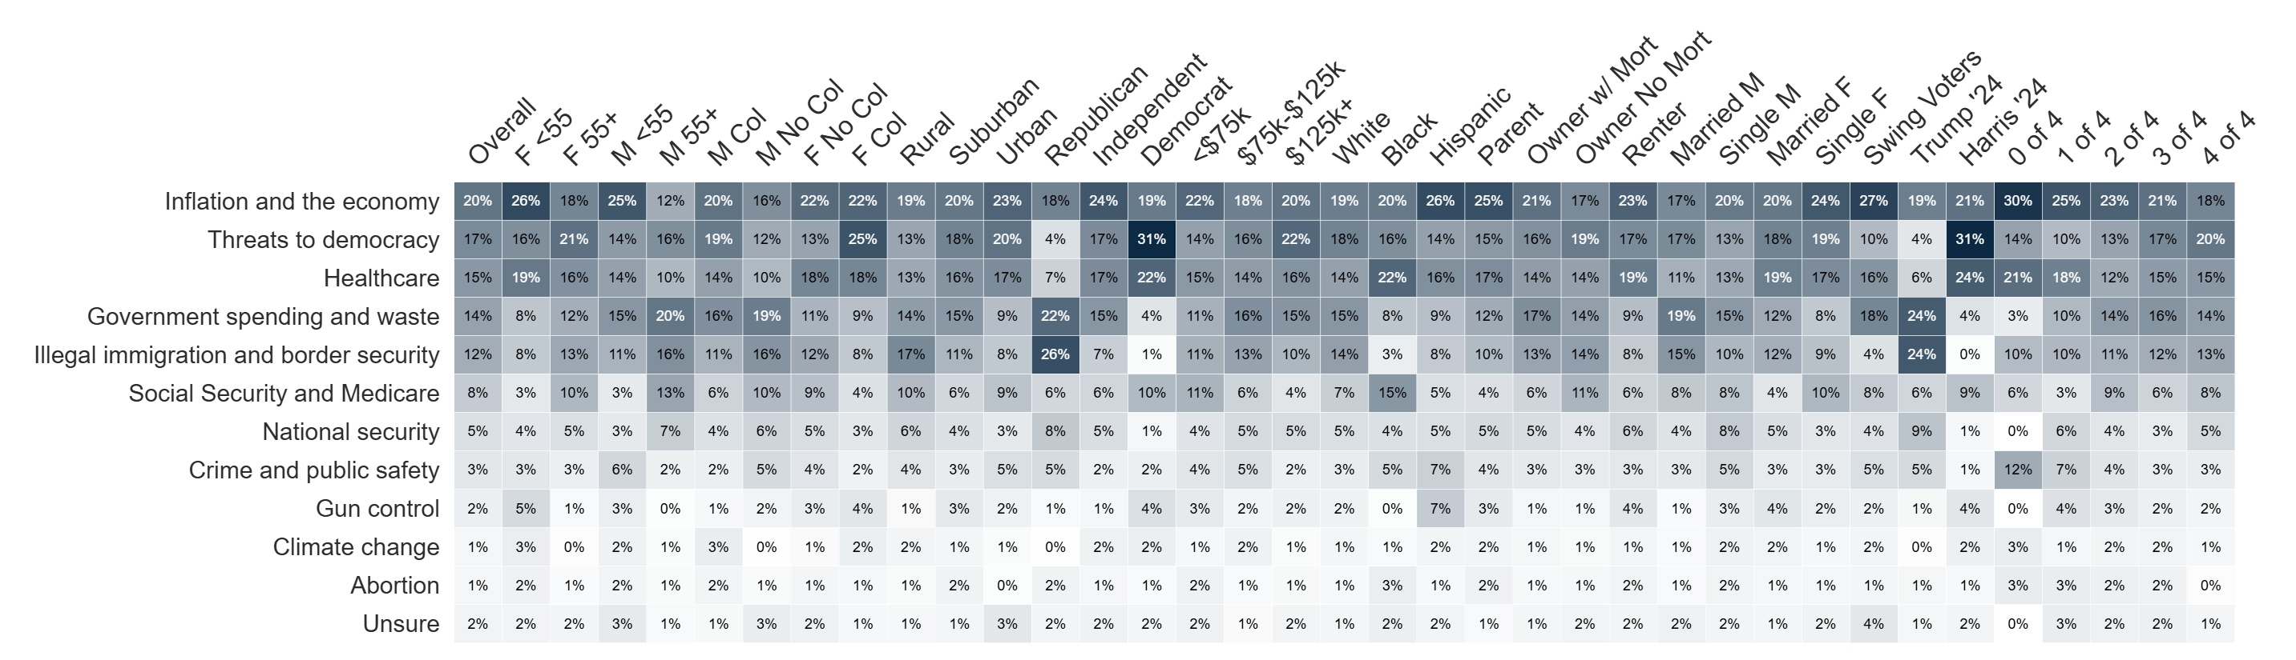
Top Priority
Which one of the following issues do you believe should be the top priority for Congress?

Slide 8
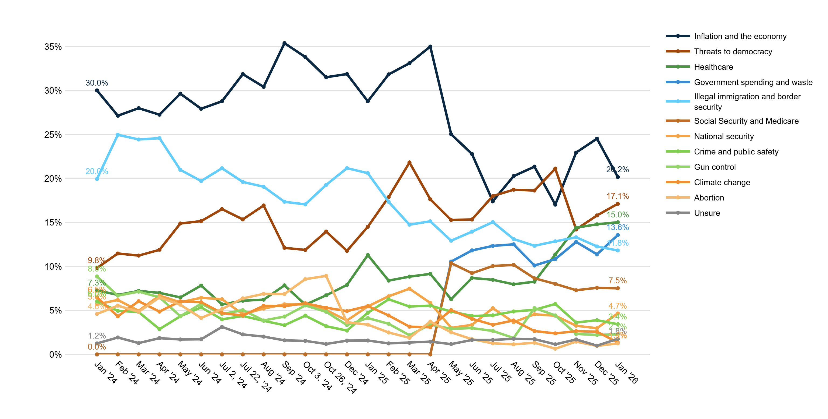
Trend: Top Priority

Slide 9
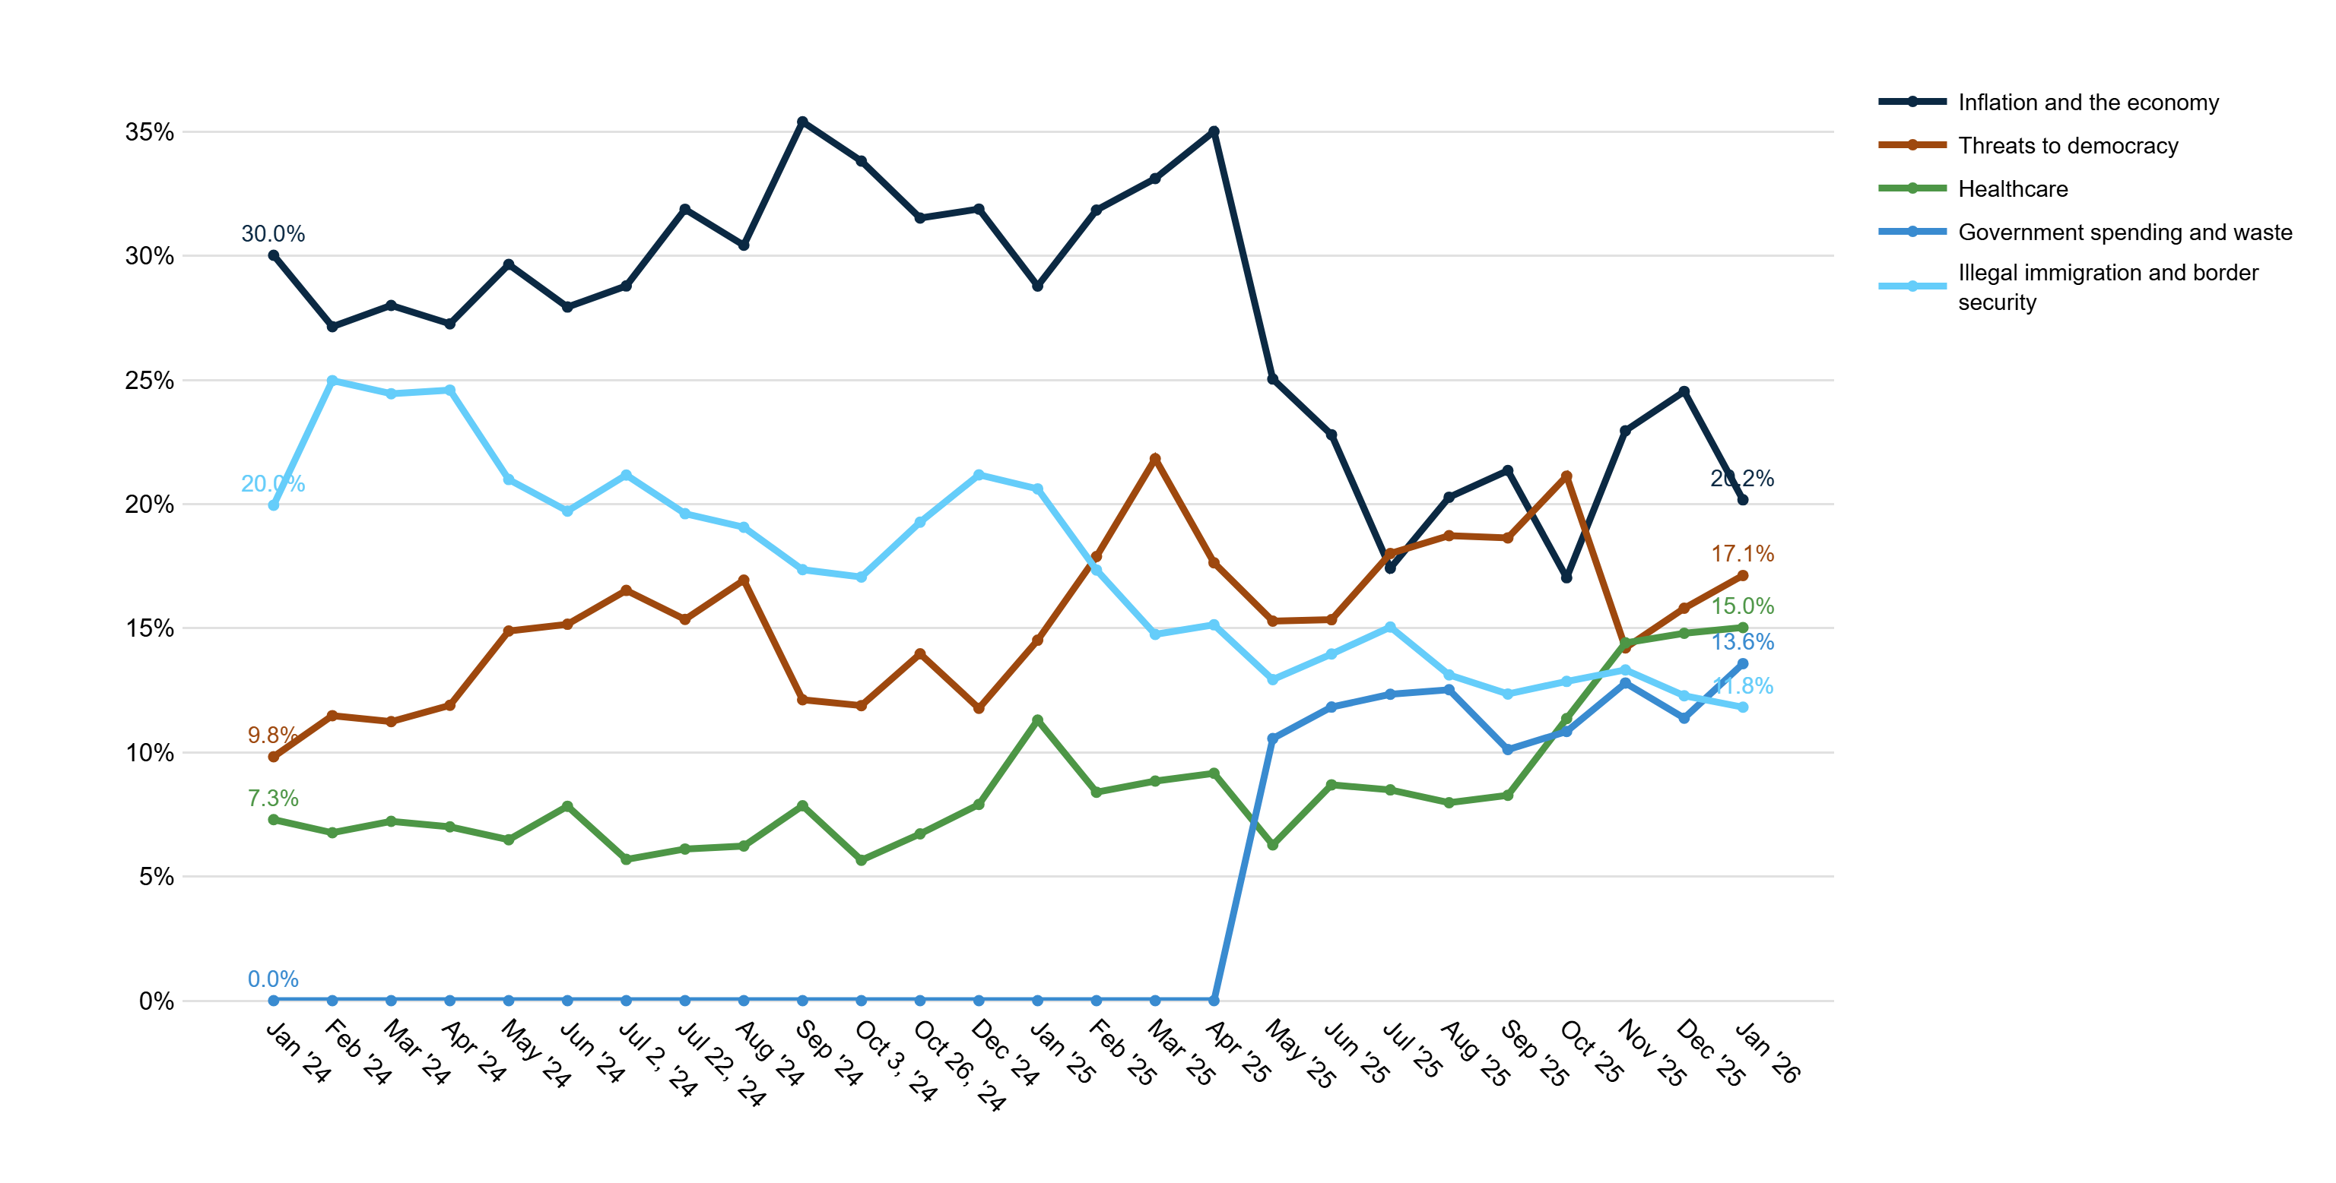
Trend: Top Priority (At Least 10%)

Slide 10
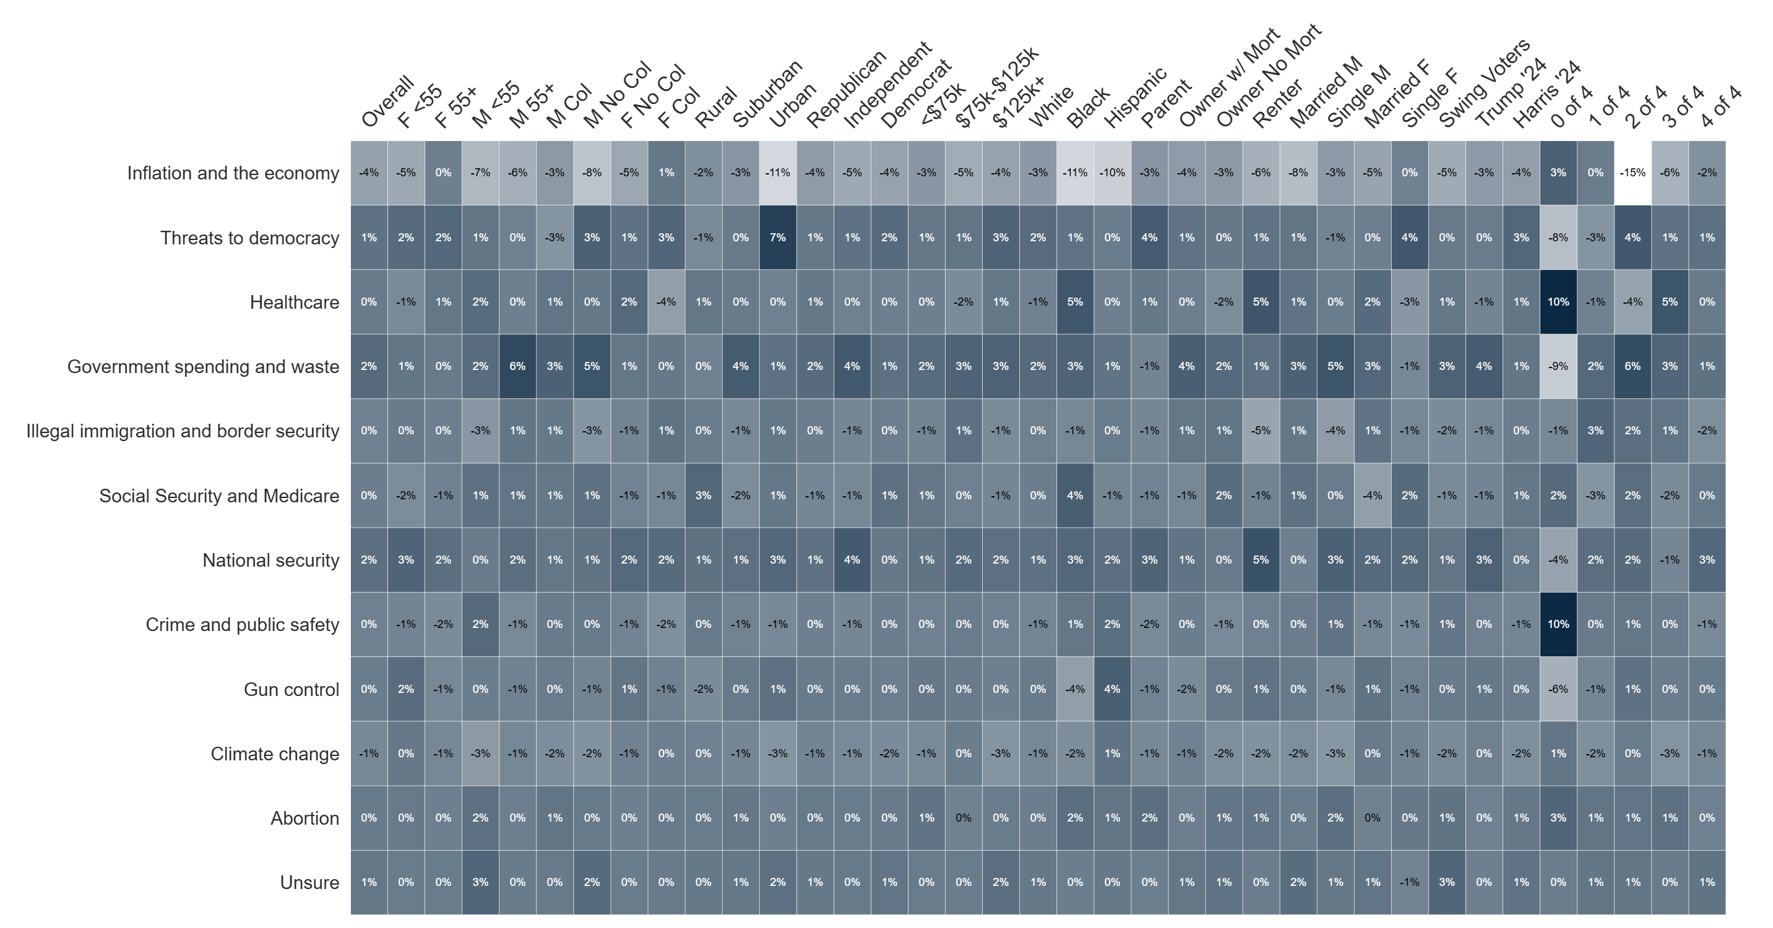
Percent Change: Top Priority (Dec '25 to Jan '26)

Slide 11
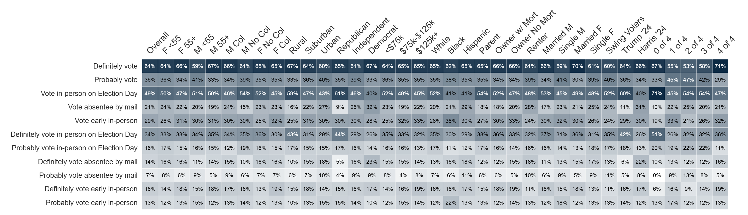
Vote Method
How do you plan to vote in the November 2026 general election for U.S. Congress and state offices?

Slide 12
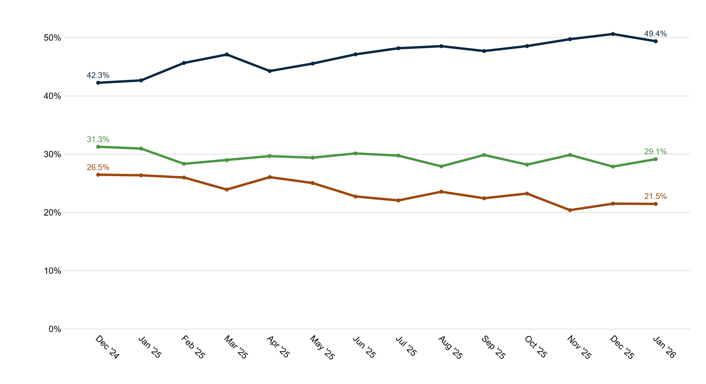
Trend: Vote Method
Vote in-person on Election Day
Vote early in-person
Vote absentee by mail

Slide 13
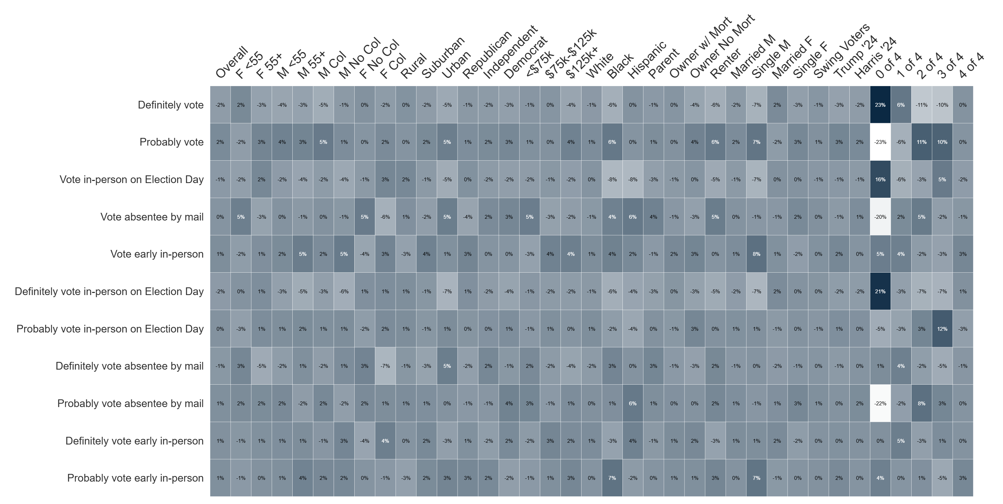
Percent Change: Vote Method (Dec '25 to Jan '26)

Slide 14
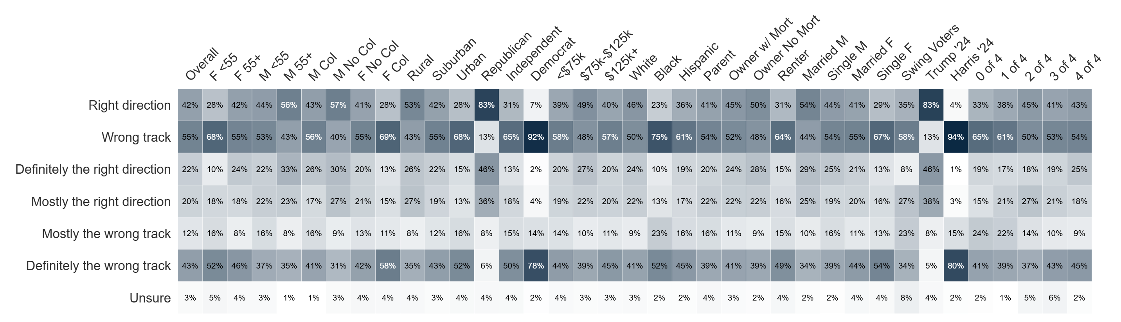
Country Direction
Generally speaking, would you say things in the United States are headed in the right direction or off on the wrong track?

Slide 15
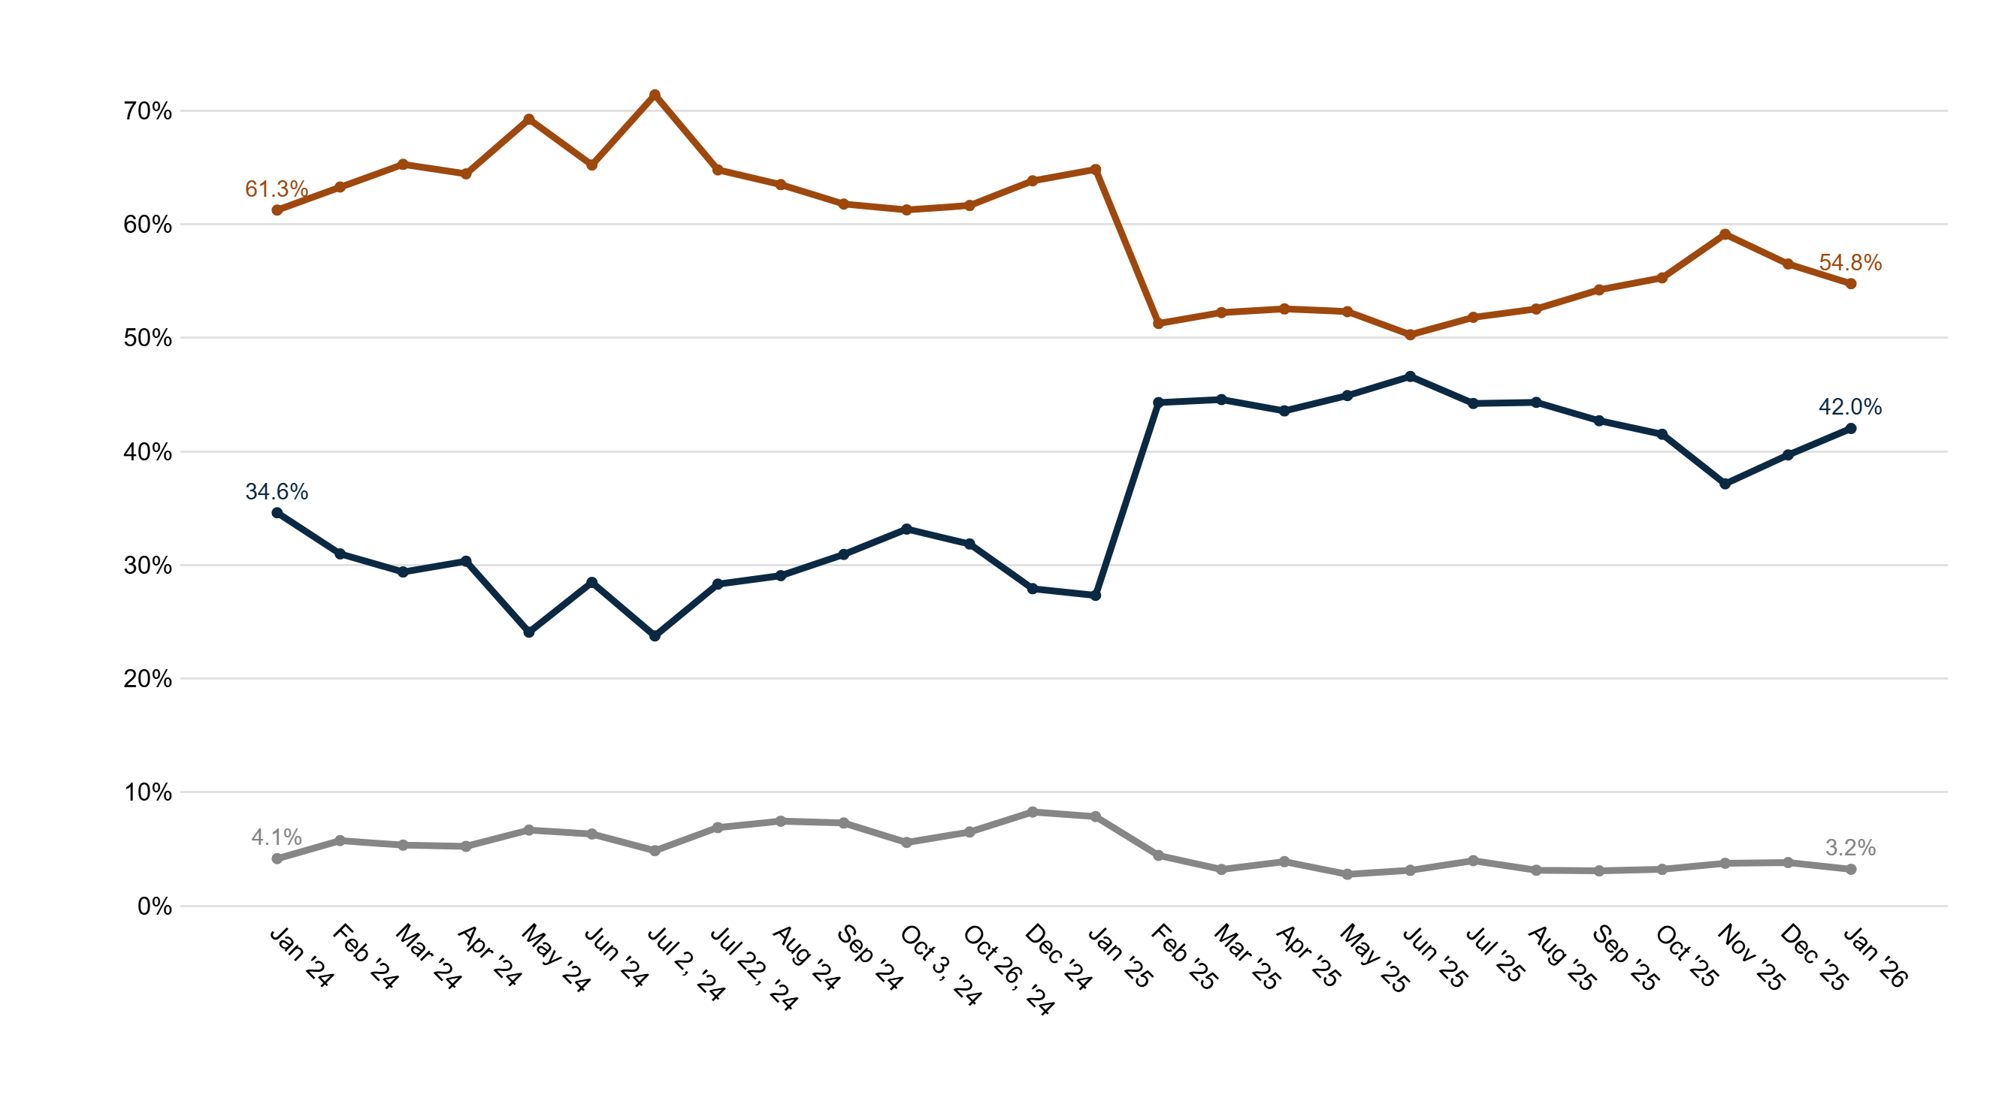
Trend: Country Direction
Wrong track
Right direction
Unsure

Slide 16
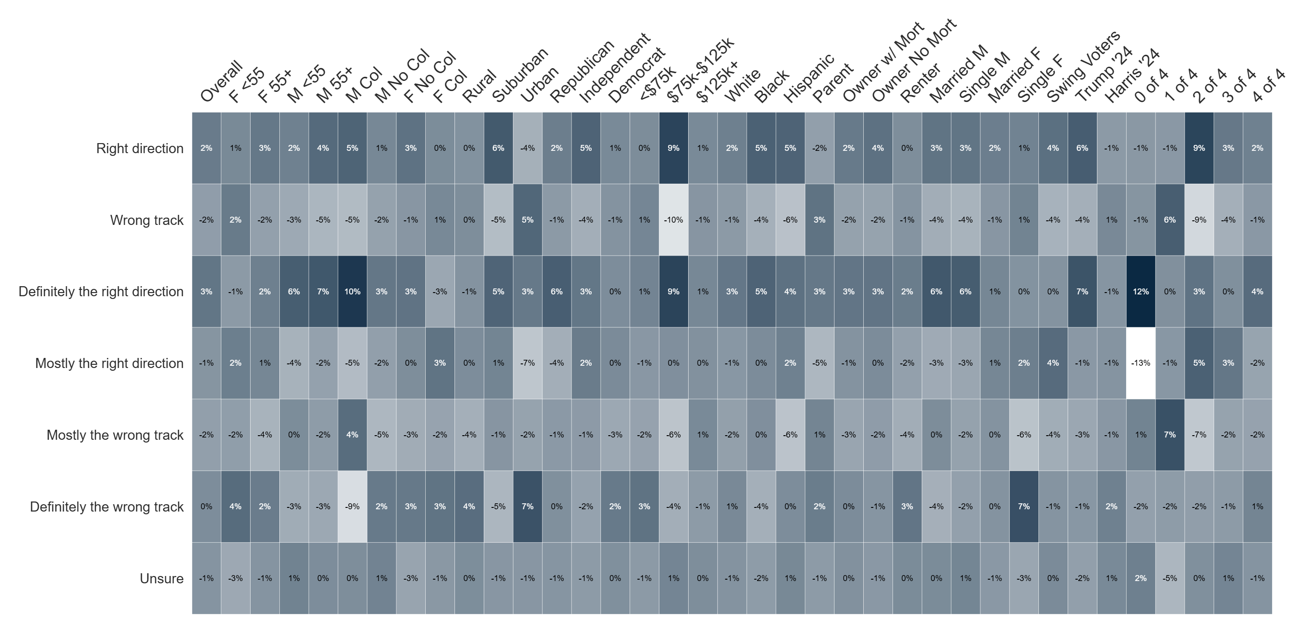
Percent Change: Country Direction (Dec '25 to Jan '26)

Slide 17
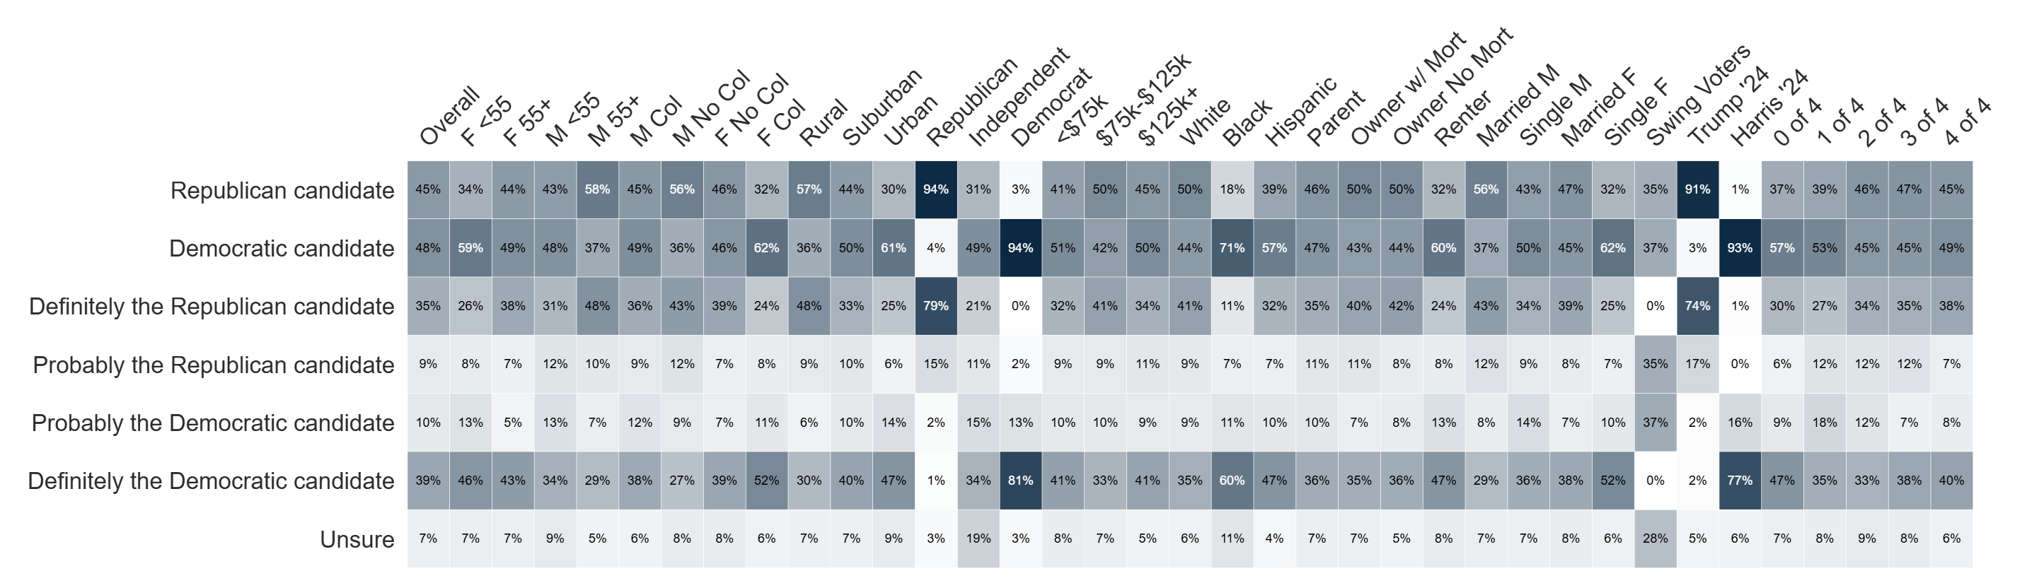
Generic Ballot
If the election was held today, and you had to make a choice, would you vote for the Republican or Democratic candidate for
U.S. Congress?

Slide 18
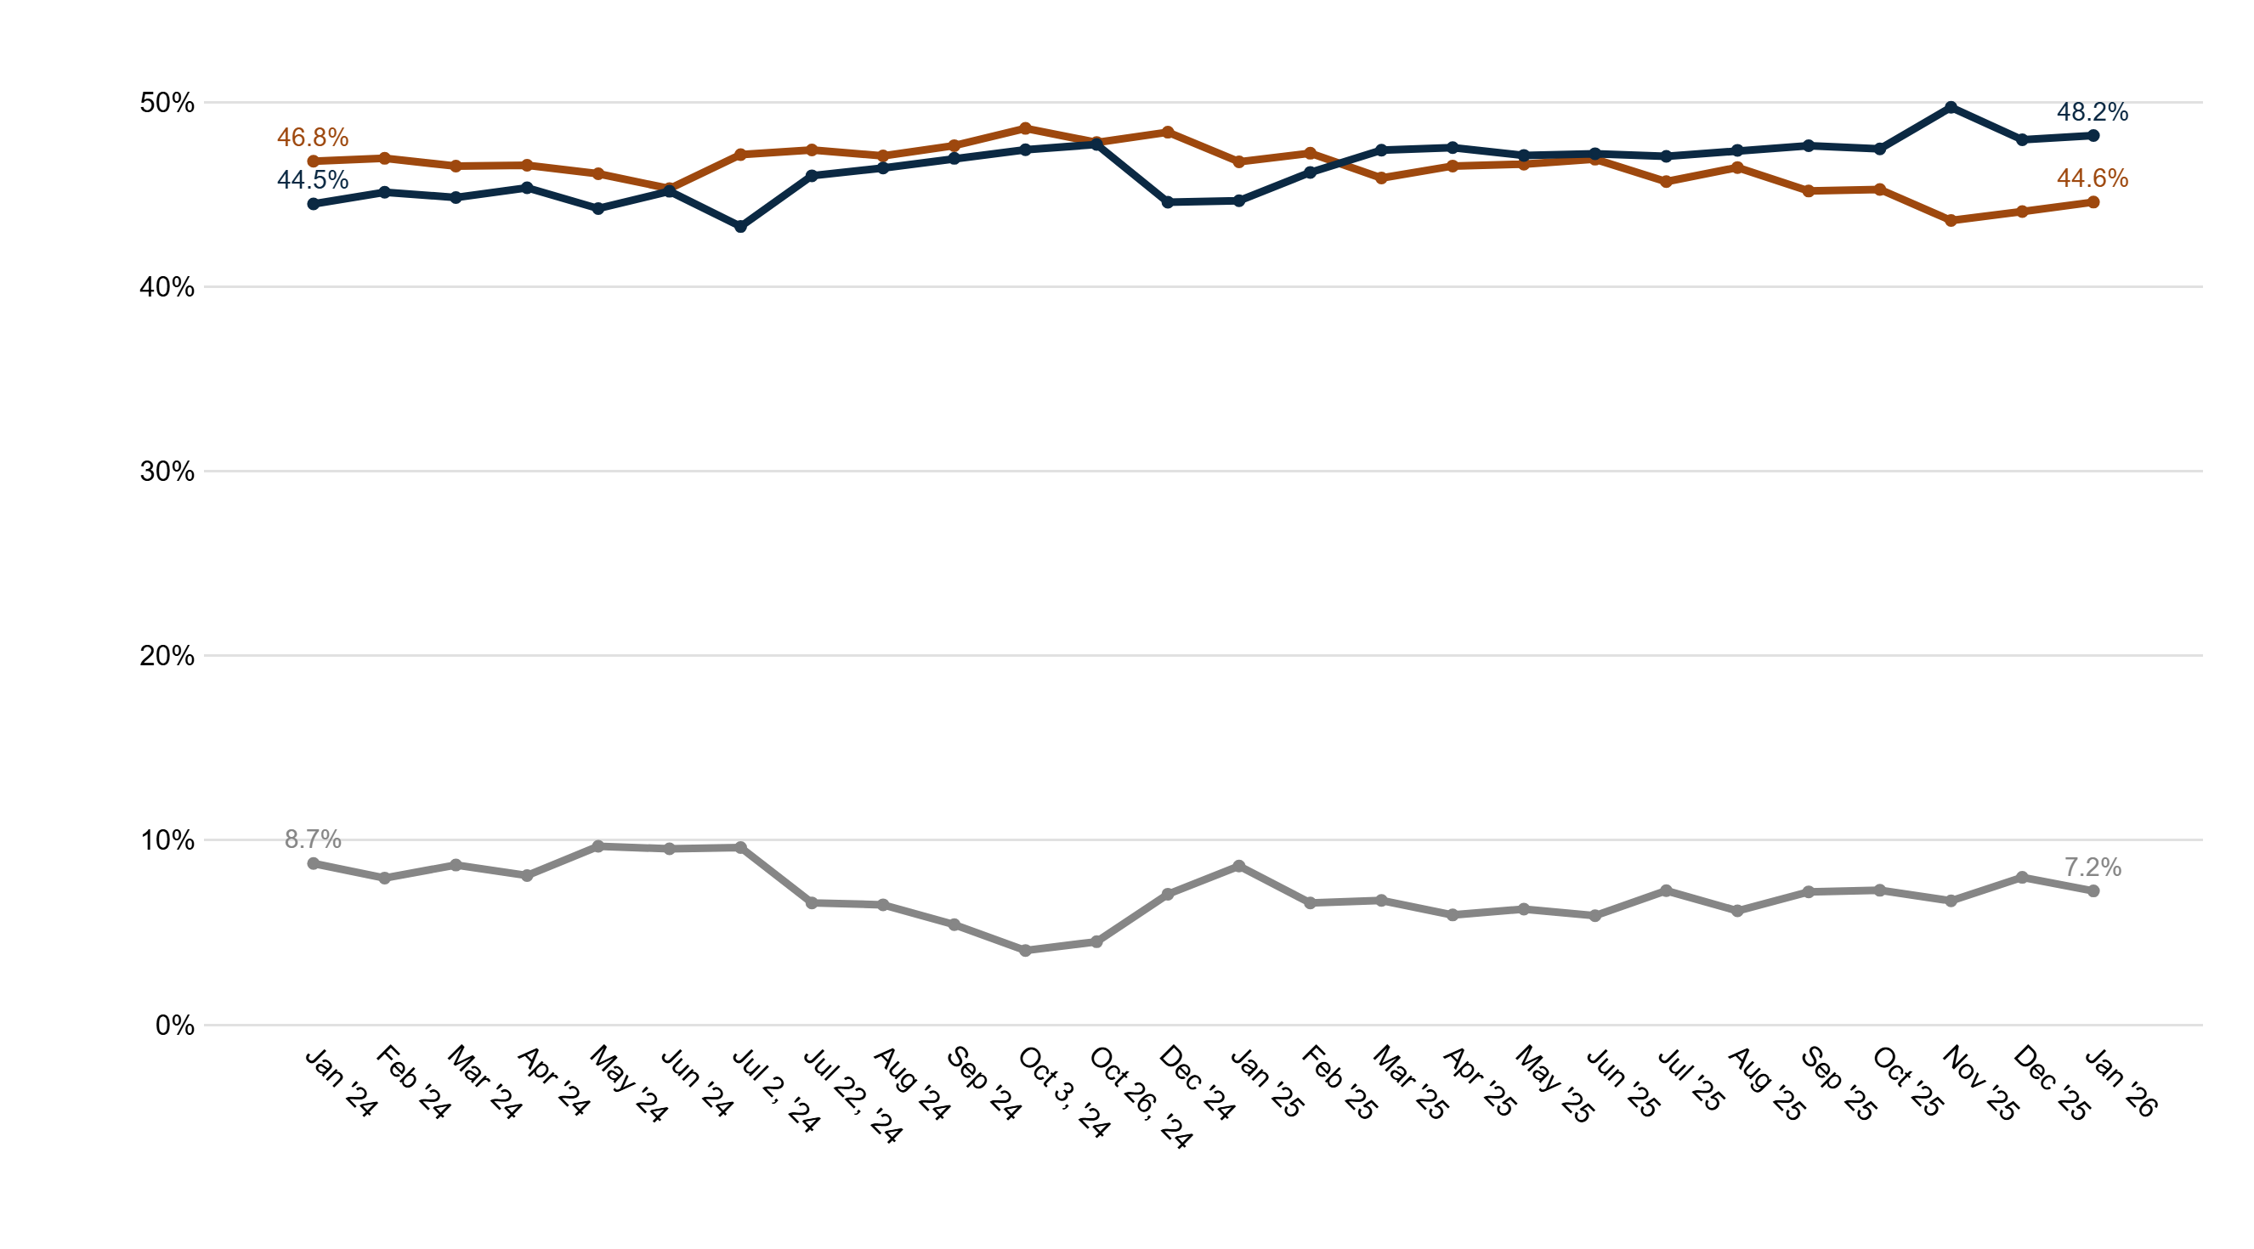
Trend: Generic Ballot
Democratic candidate
Republican candidate
Unsure

Slide 19
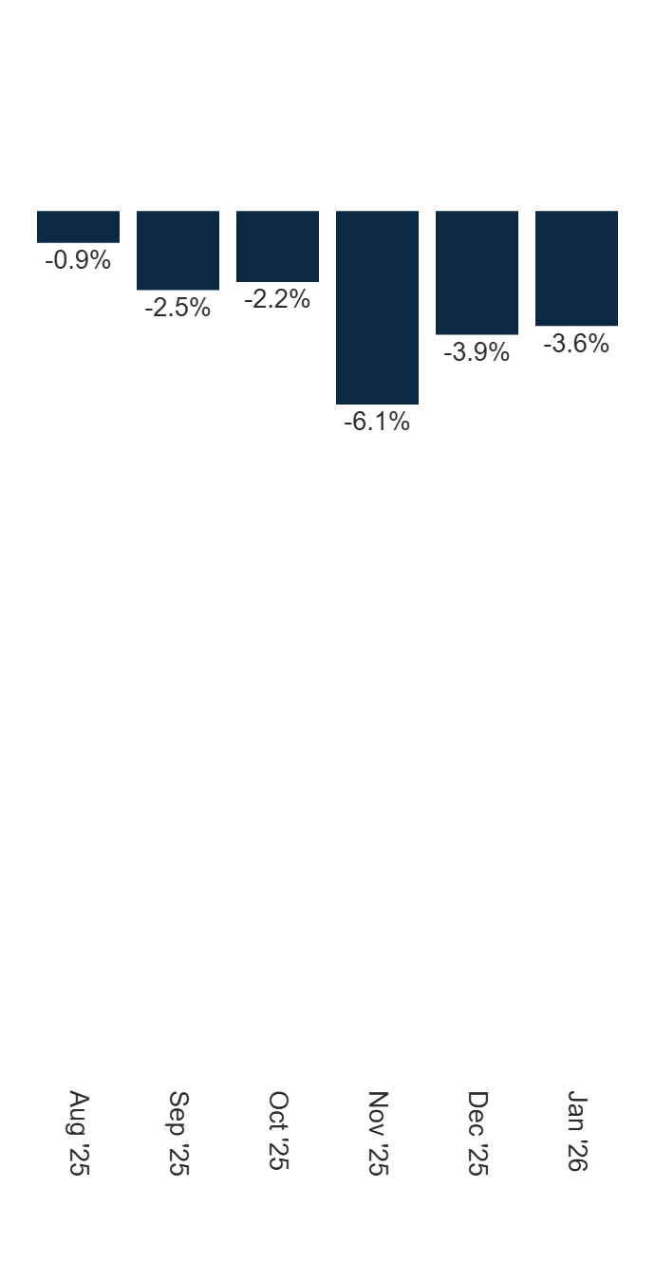
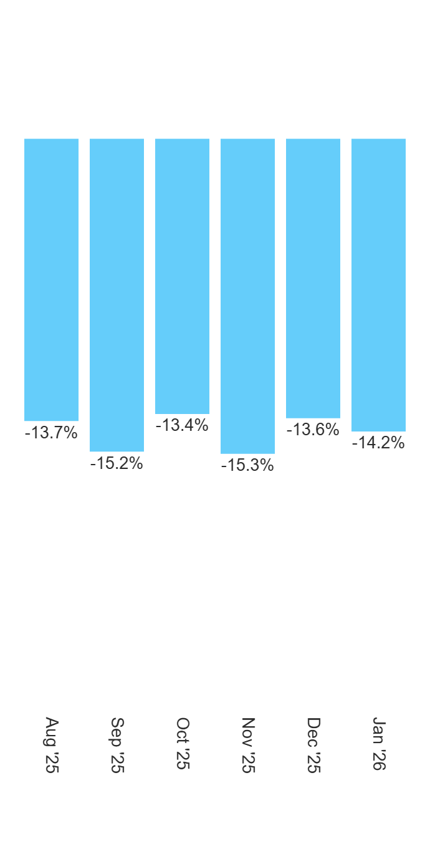
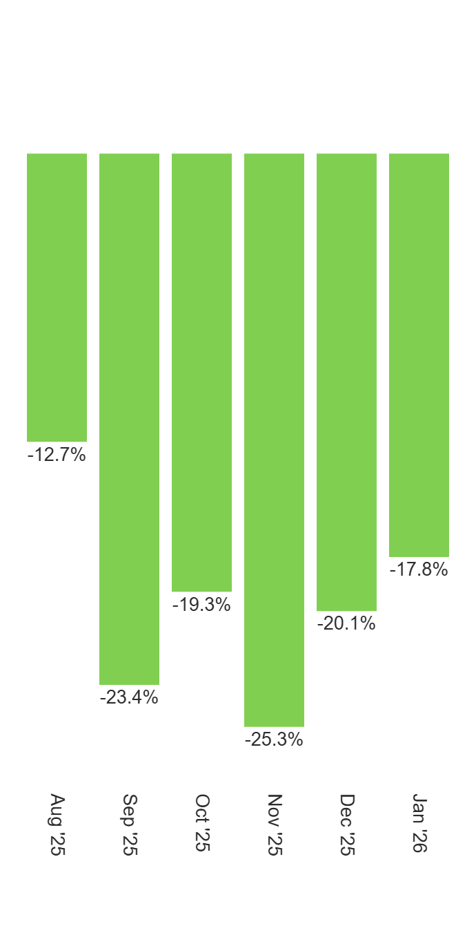
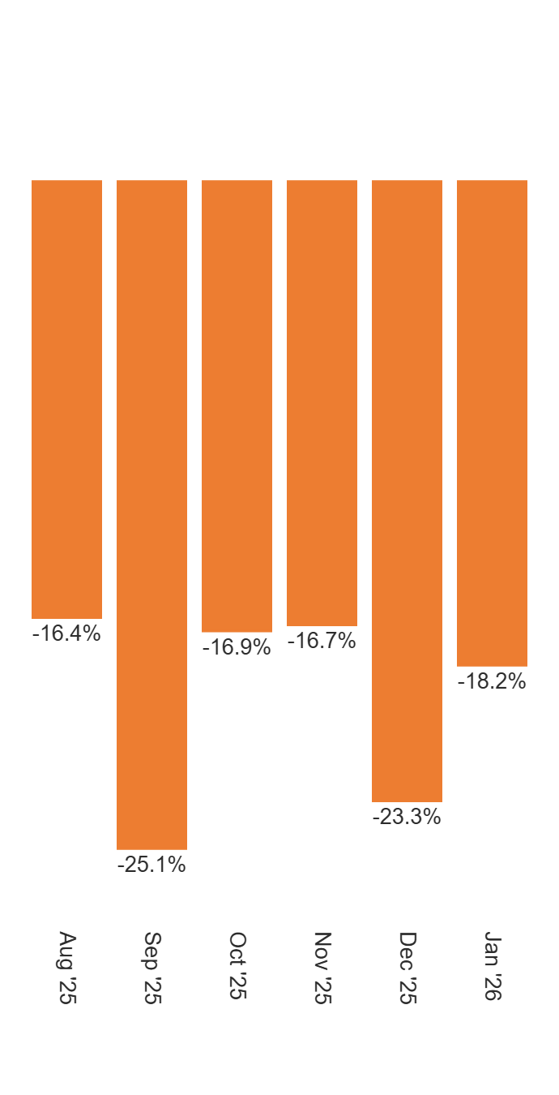
Generic Ballot Movement
Overall (%Rep-%Dem)
Females (%Rep-%Dem)
Indies (%Rep-%Dem)
College (%Rep-%Dem)

Slide 20
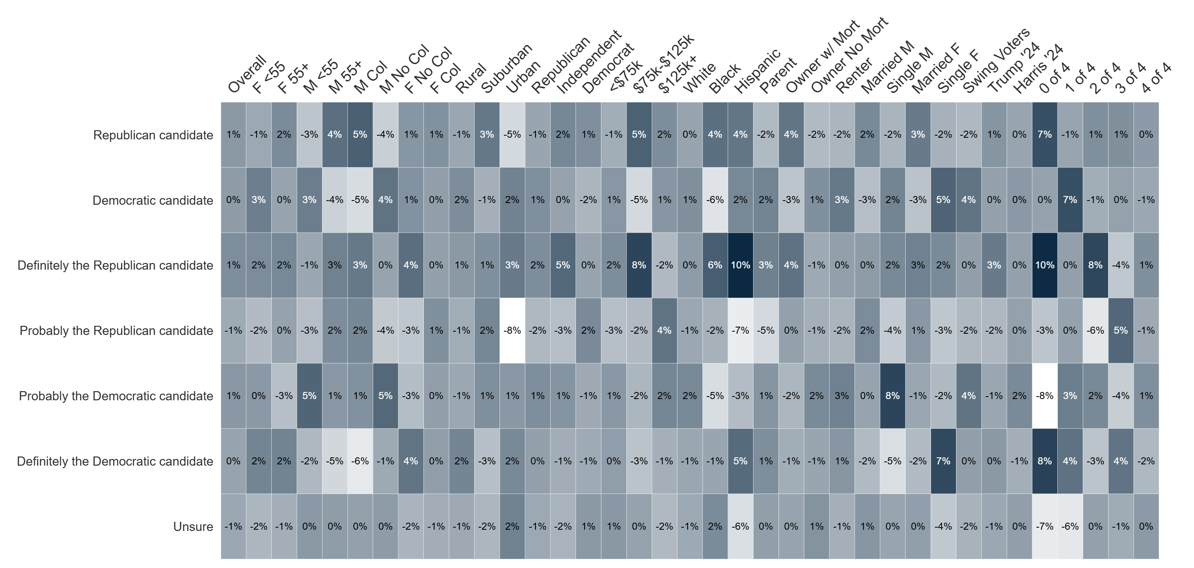
Percent Change: Generic Ballot (Dec '25 to Jan '26)

Slide 21
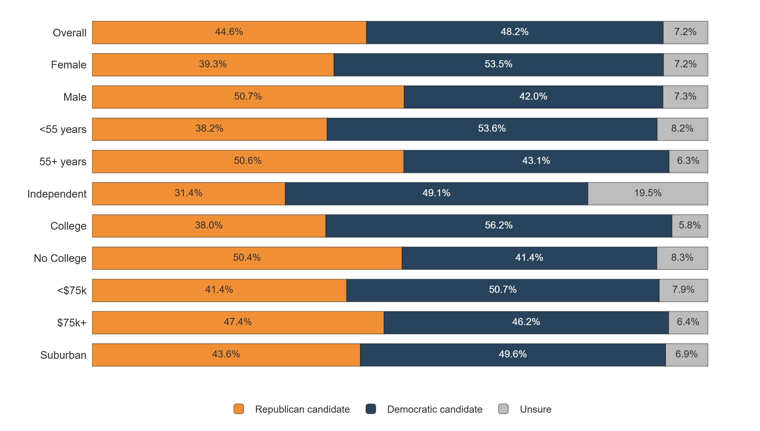
Generic Ballot by Key Voter Groups

Slide 22
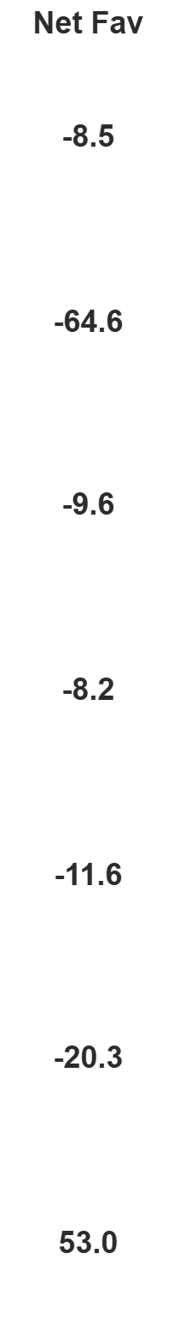
Image Tests

Slide 23
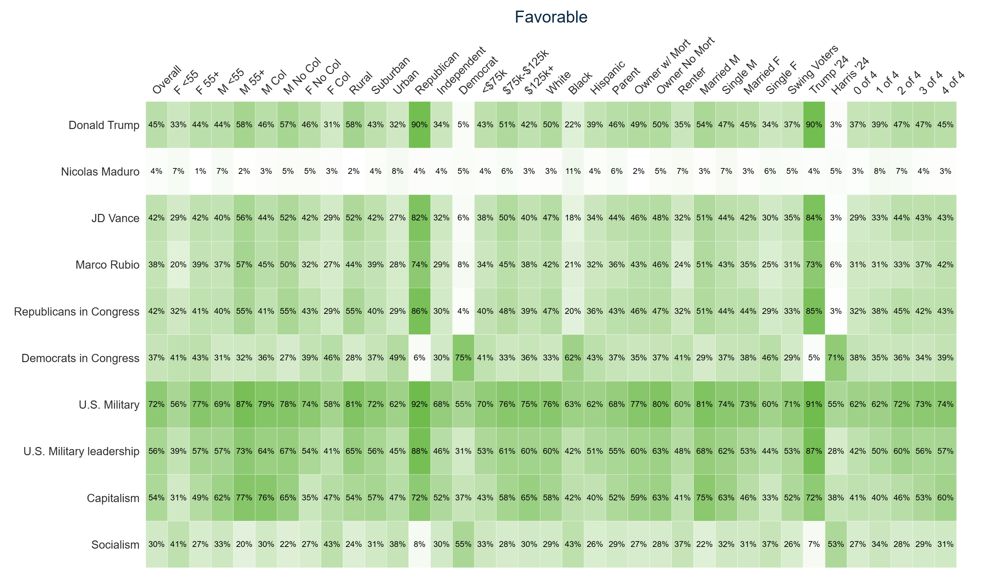
Image Tests Heatmap - Favorable

Slide 24
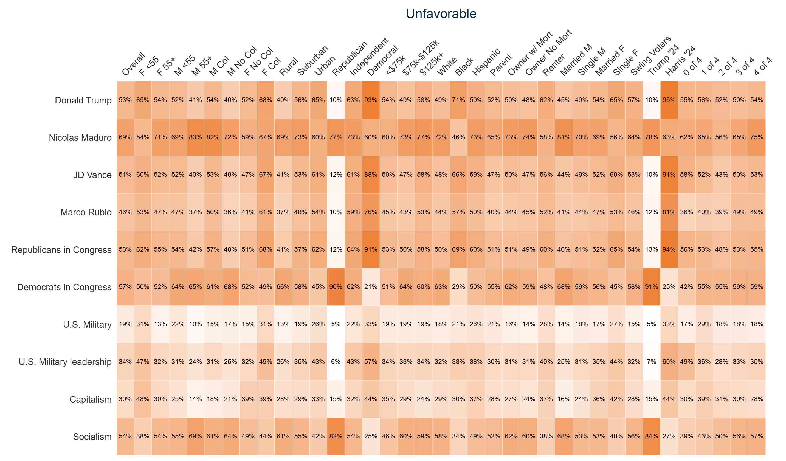
Image Tests Heatmap - Unfavorable

Slide 25
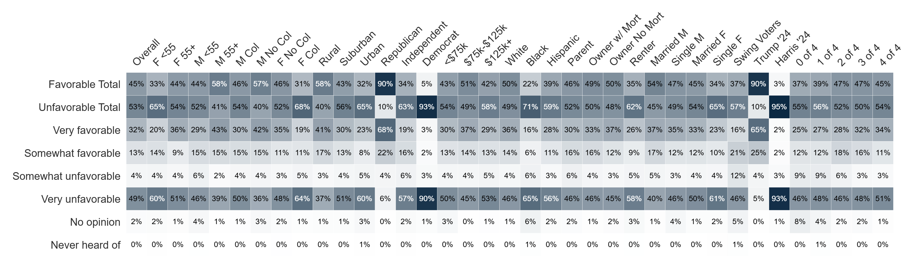
Image: Donald Trump
Do you have a favorable or unfavorable opinion of Donald Trump?

Slide 26
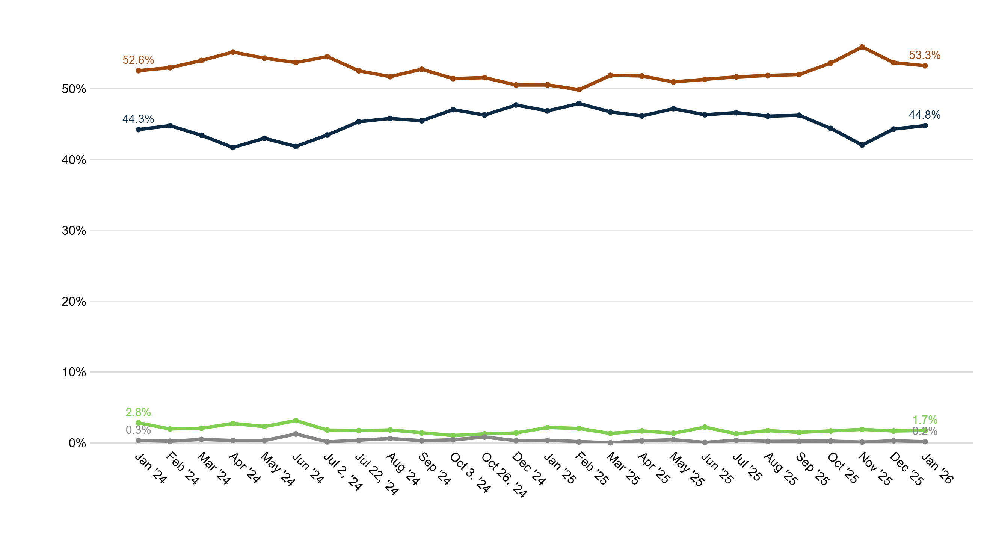
Trend: Donald Trump Image
Unfavorable
Favorable
No opinion
Never heard of

Slide 27
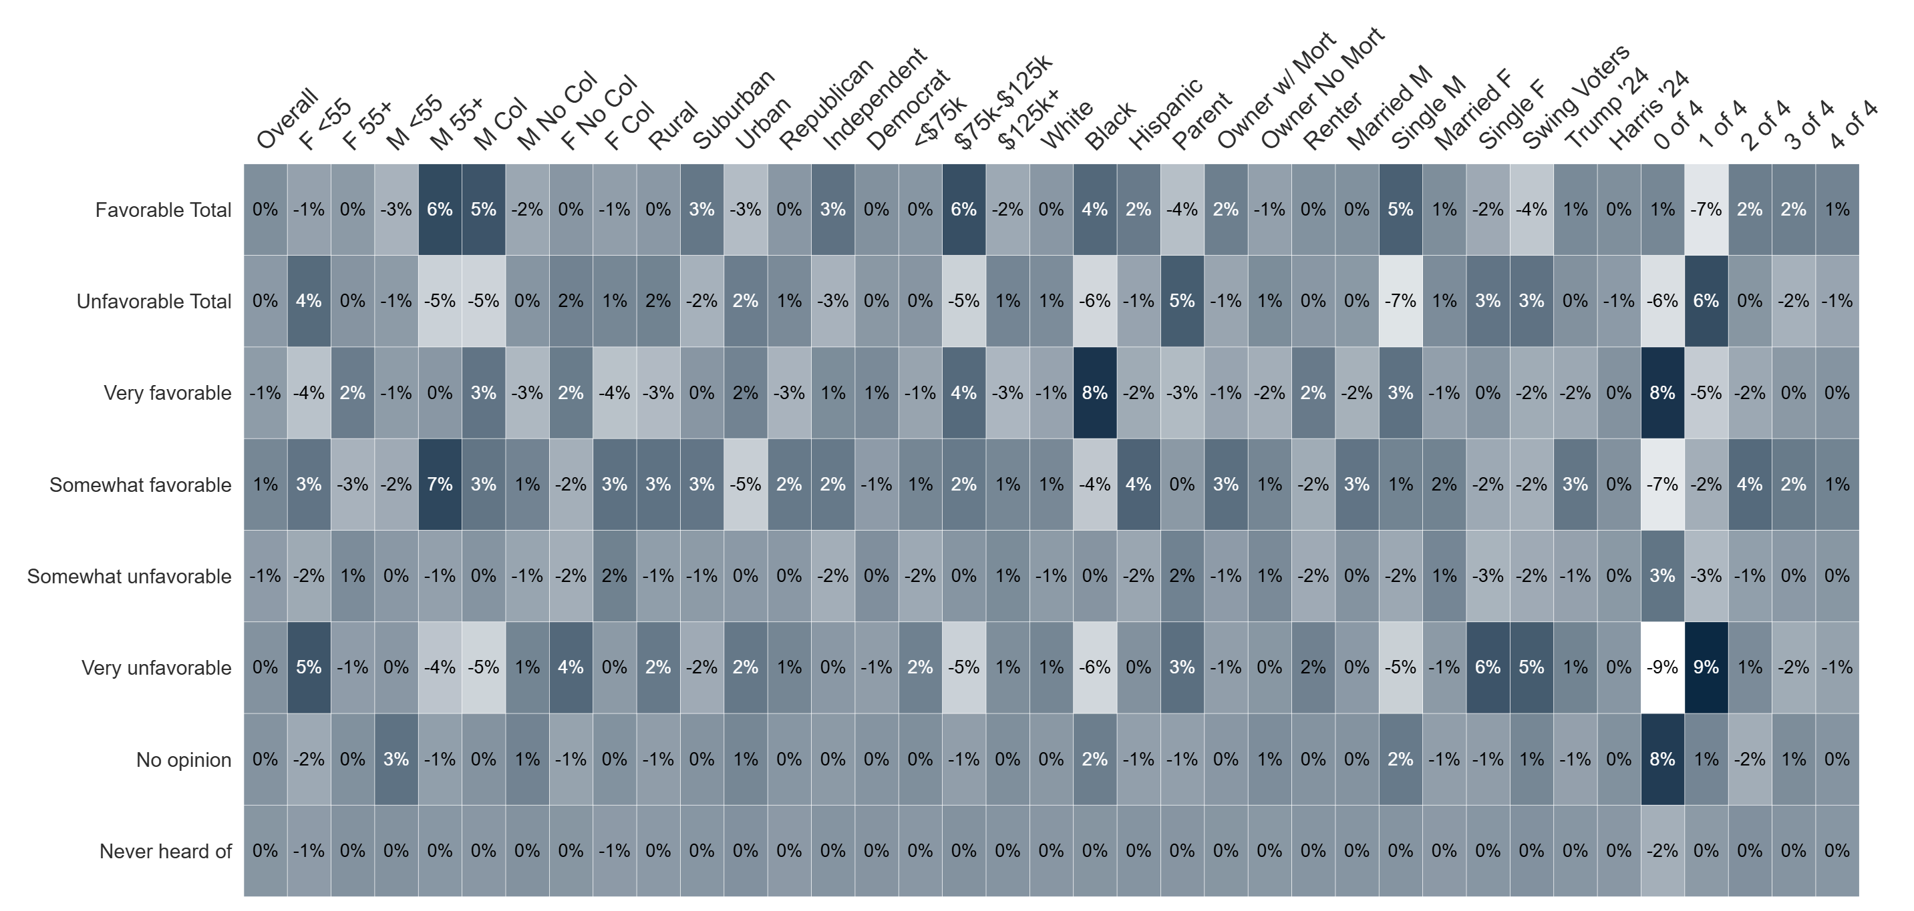
Percent Change: Donald Trump Image (Dec '25 to Jan '26)

Slide 28
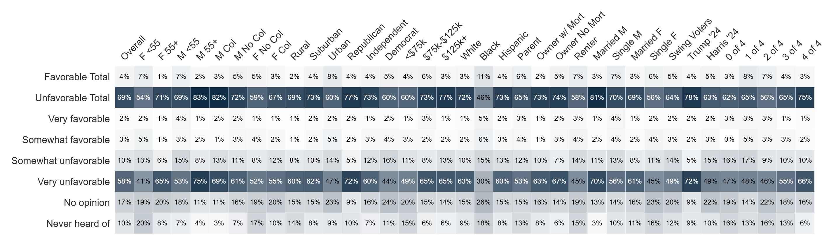
Image: Nicolas Maduro
Do you have a favorable or unfavorable opinion of Nicolas Maduro?

Slide 29
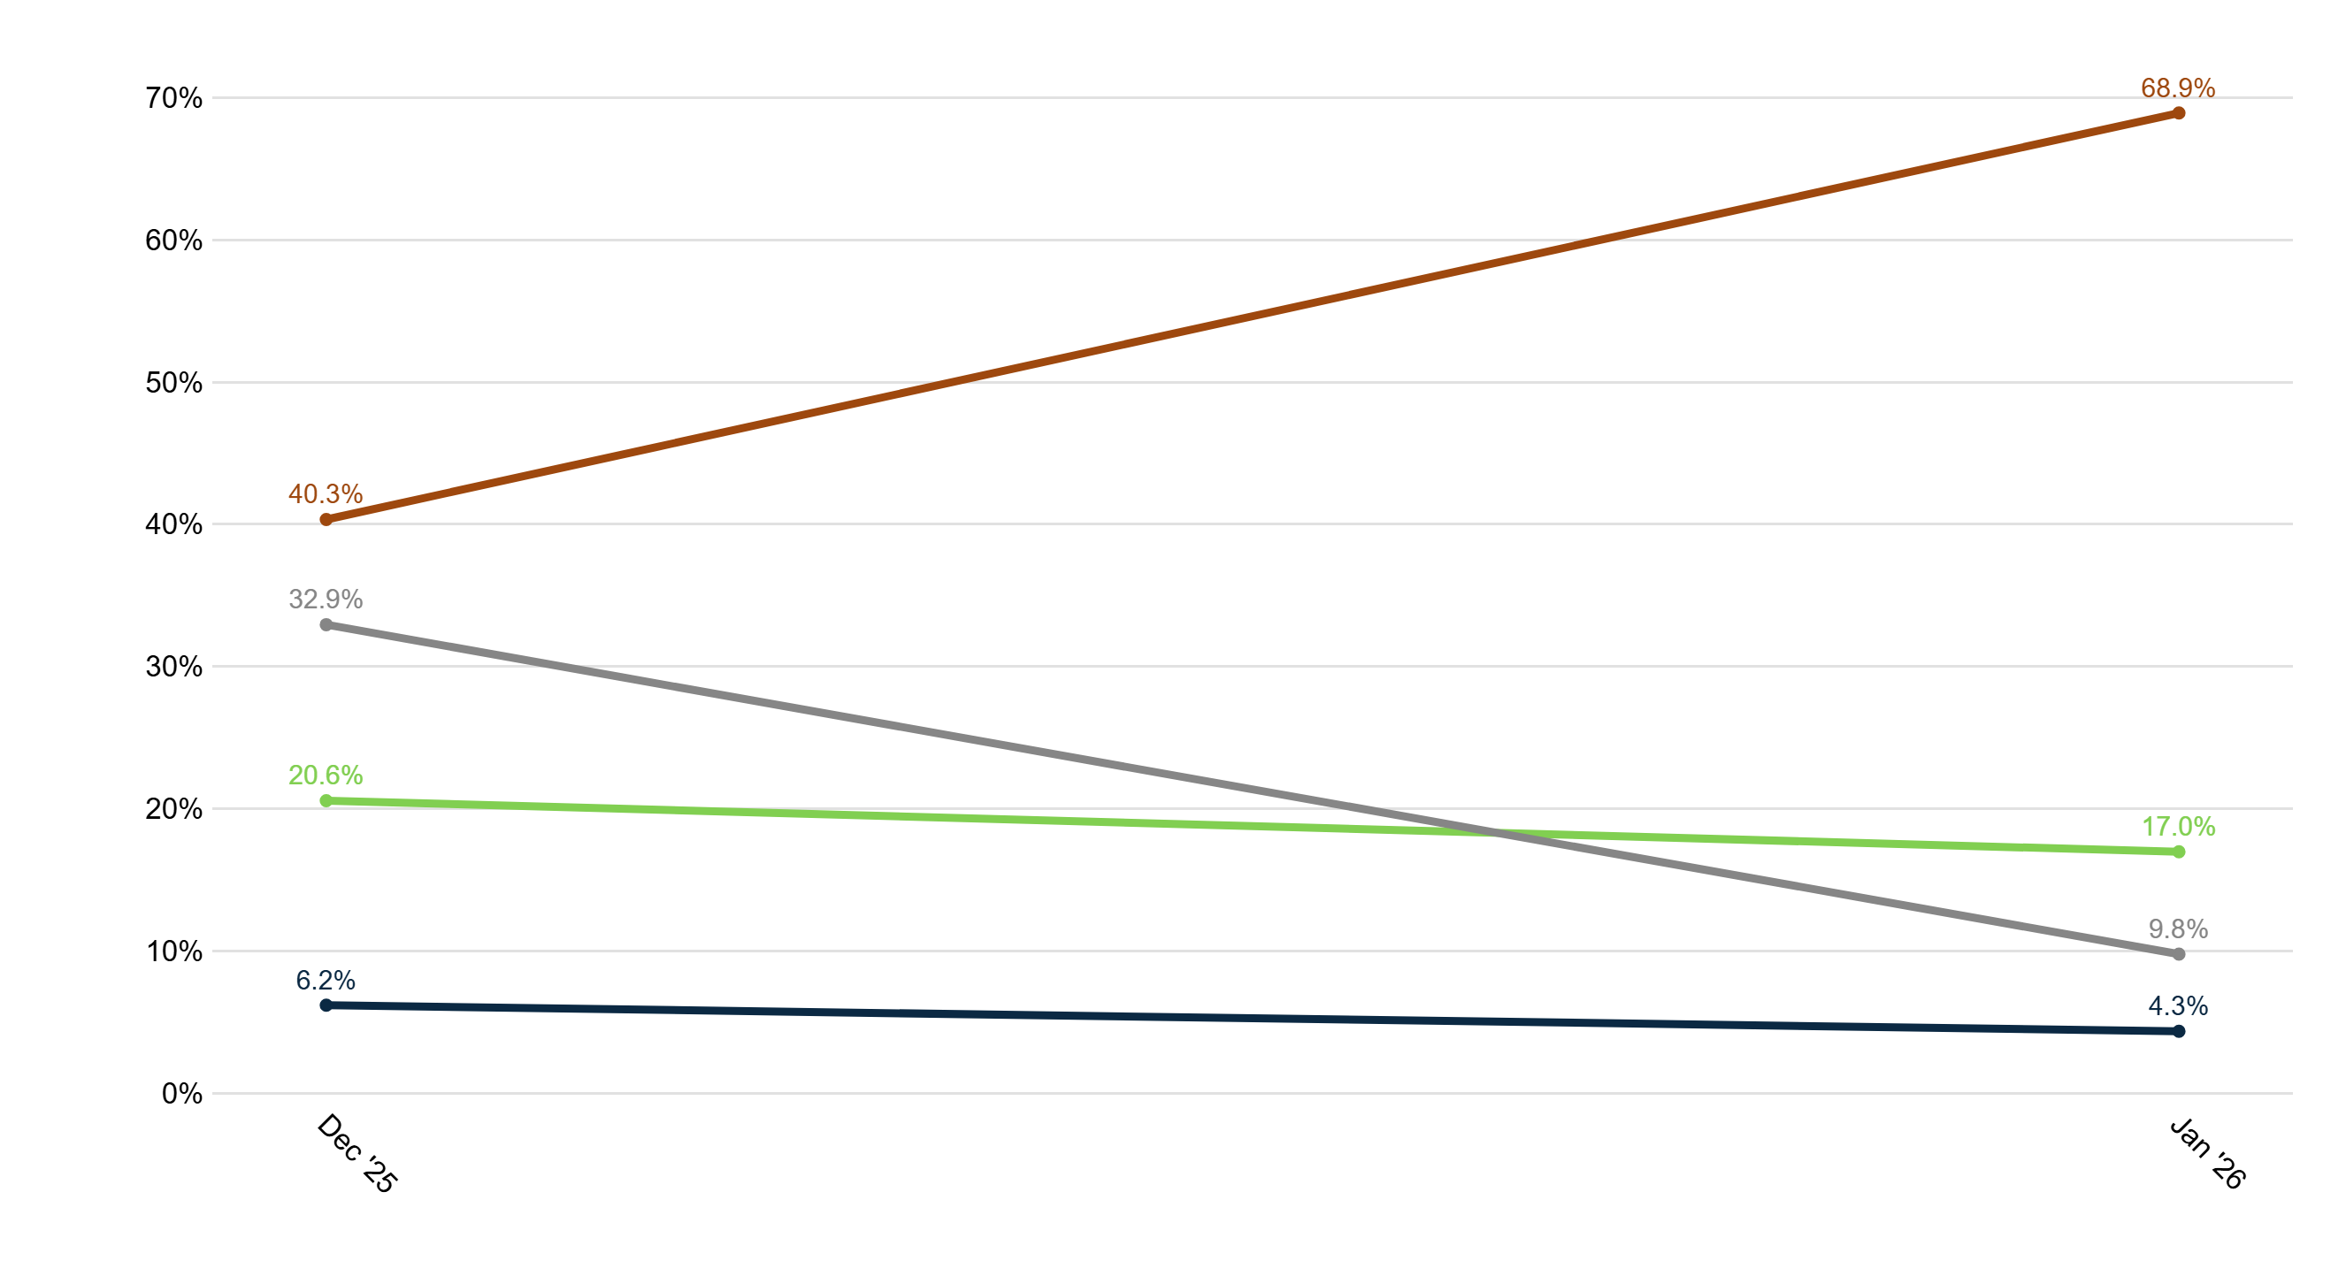
Trend: Nicolas Maduro Image
Unfavorable
No opinion
Never heard of
Favorable

Slide 30
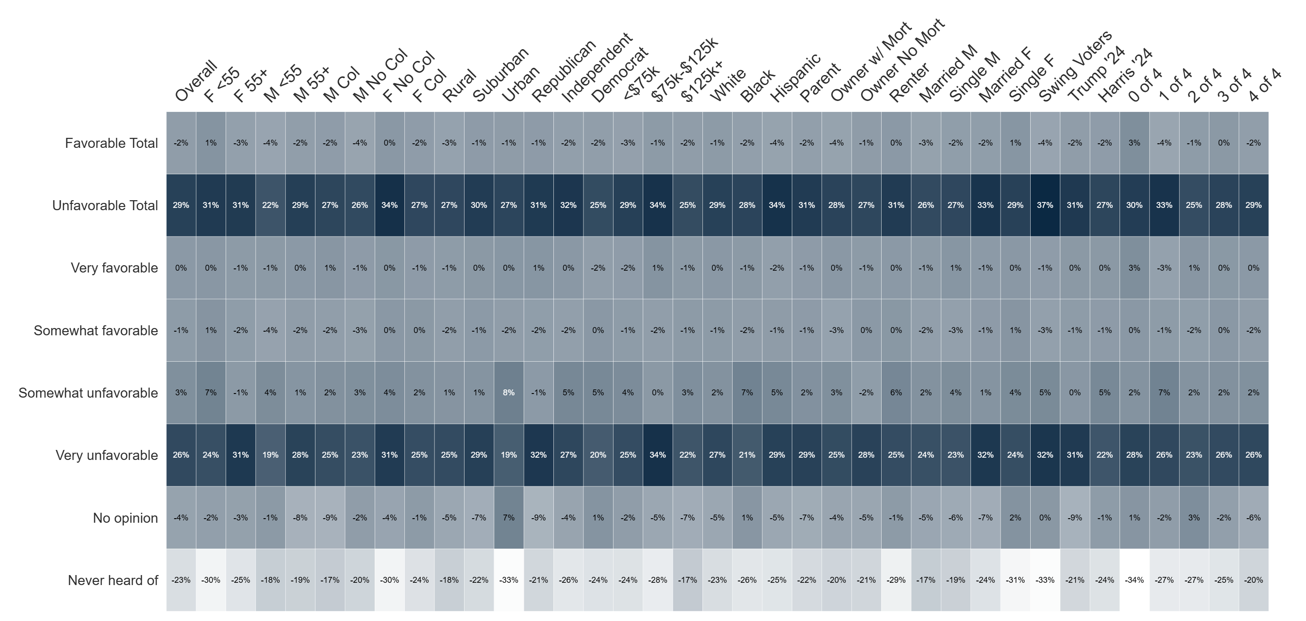
Percent Change: Nicolas Maduro Image (Dec '25 to Jan '26)

Slide 31
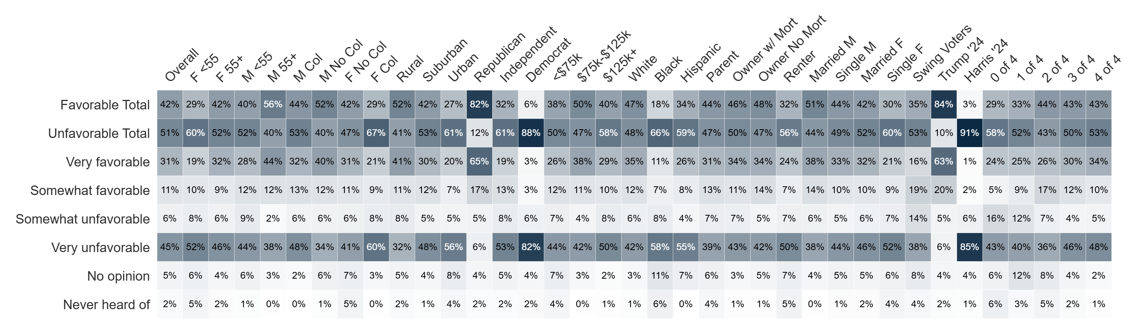
Image: JD Vance
Do you have a favorable or unfavorable opinion of JD Vance?

Slide 32
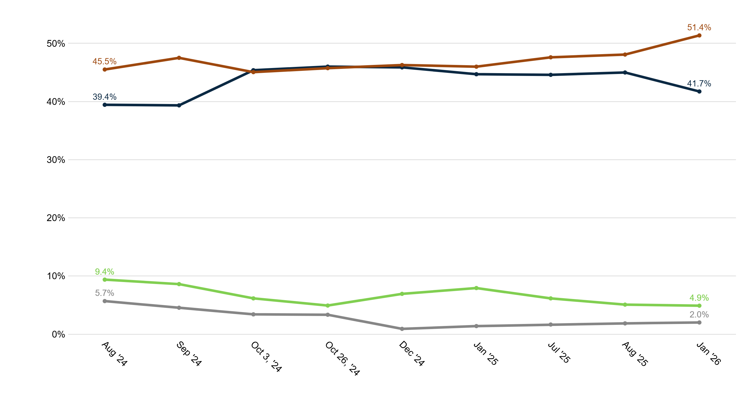
Trend: JD Vance Image
Unfavorable
Favorable
No opinion
Never heard of

Slide 33
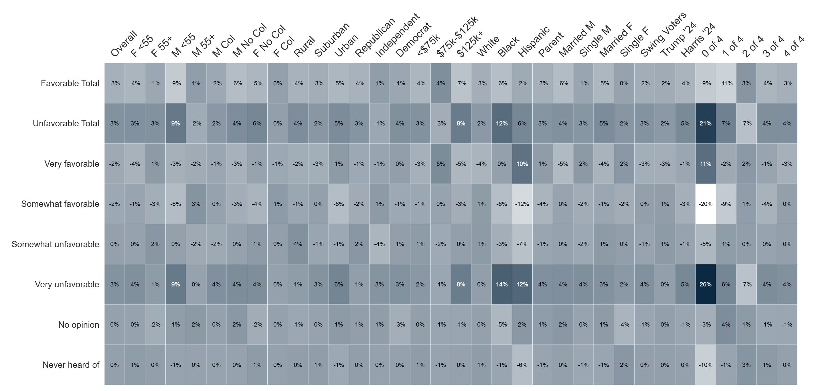
Percent Change: JD Vance Image (Aug '25 to Jan '26)

Slide 34
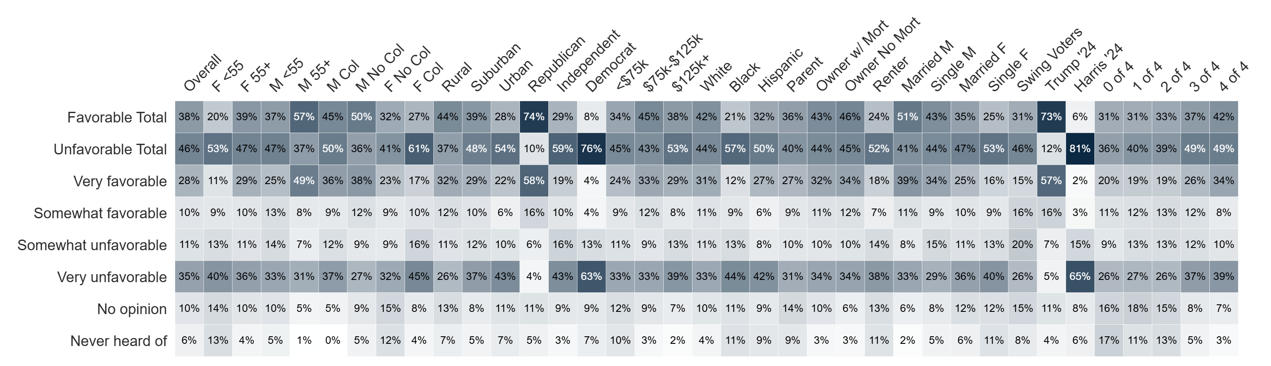
Image: Marco Rubio
Do you have a favorable or unfavorable opinion of Marco Rubio?

Slide 35
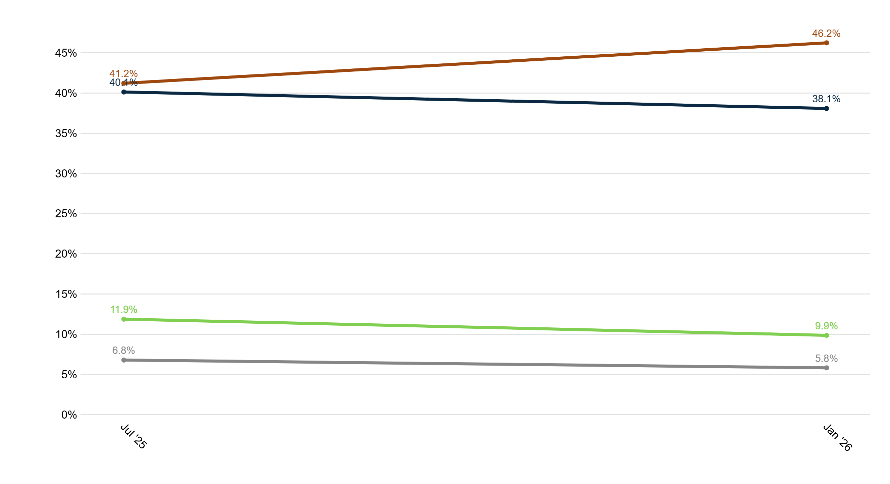
Trend: Marco Rubio Image
Unfavorable
Favorable
No opinion
Never heard of

Slide 36
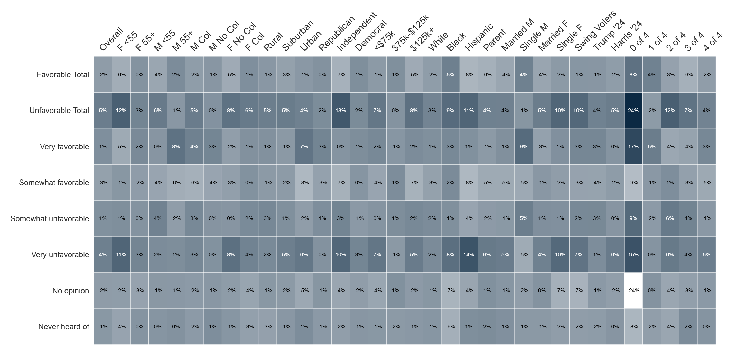
Percent Change: Marco Rubio Image (Jul '25 to Jan '26)

Slide 37
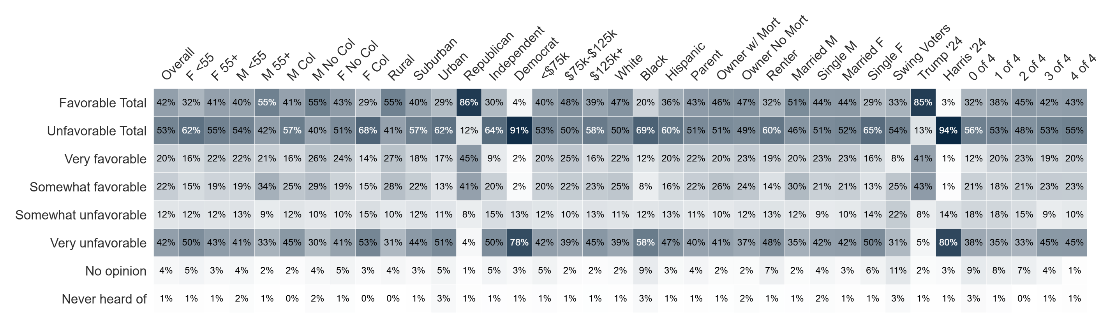
Image: Republicans in Congress
Do you have a favorable or unfavorable opinion of Republicans in Congress?

Slide 38
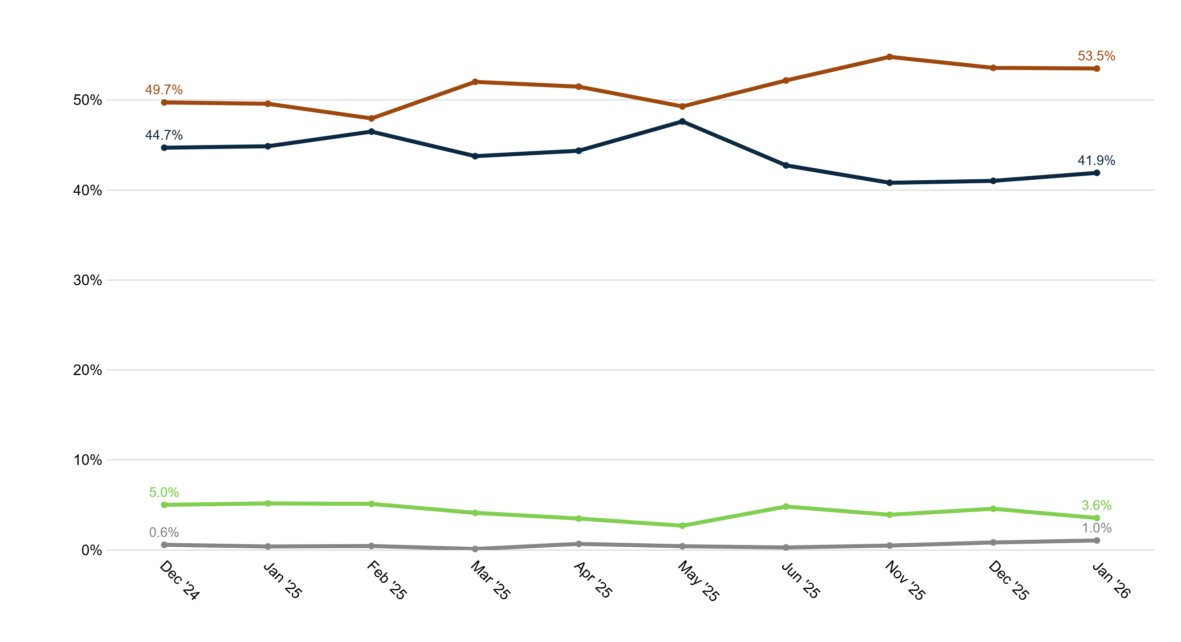
Trend: Republicans in Congress Image
Unfavorable
Favorable
No opinion
Never heard of

Slide 39
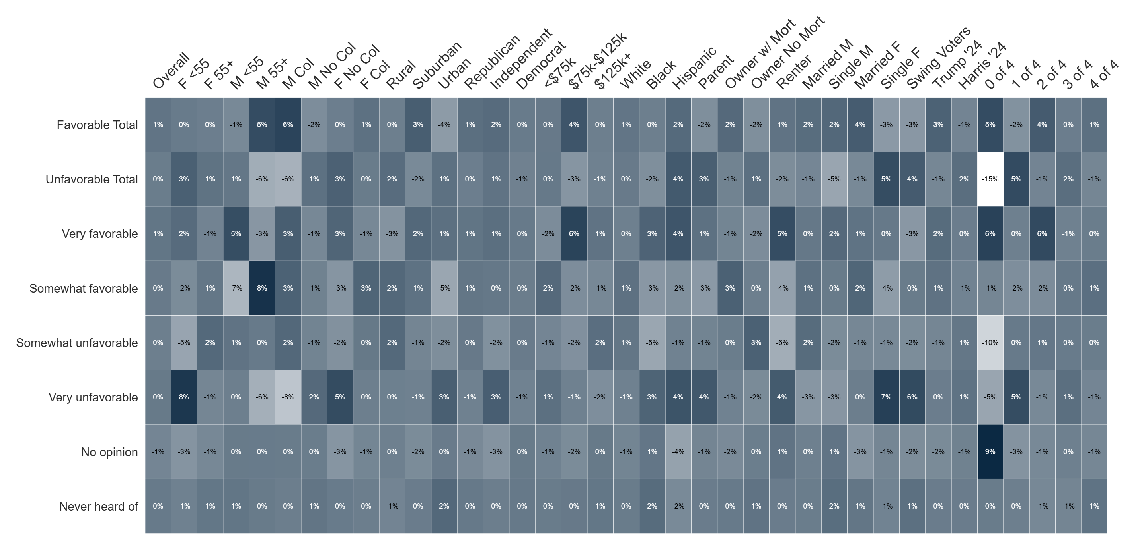
Percent Change: Republicans in Congress Image
(Dec '25 to Jan '26)

Slide 40
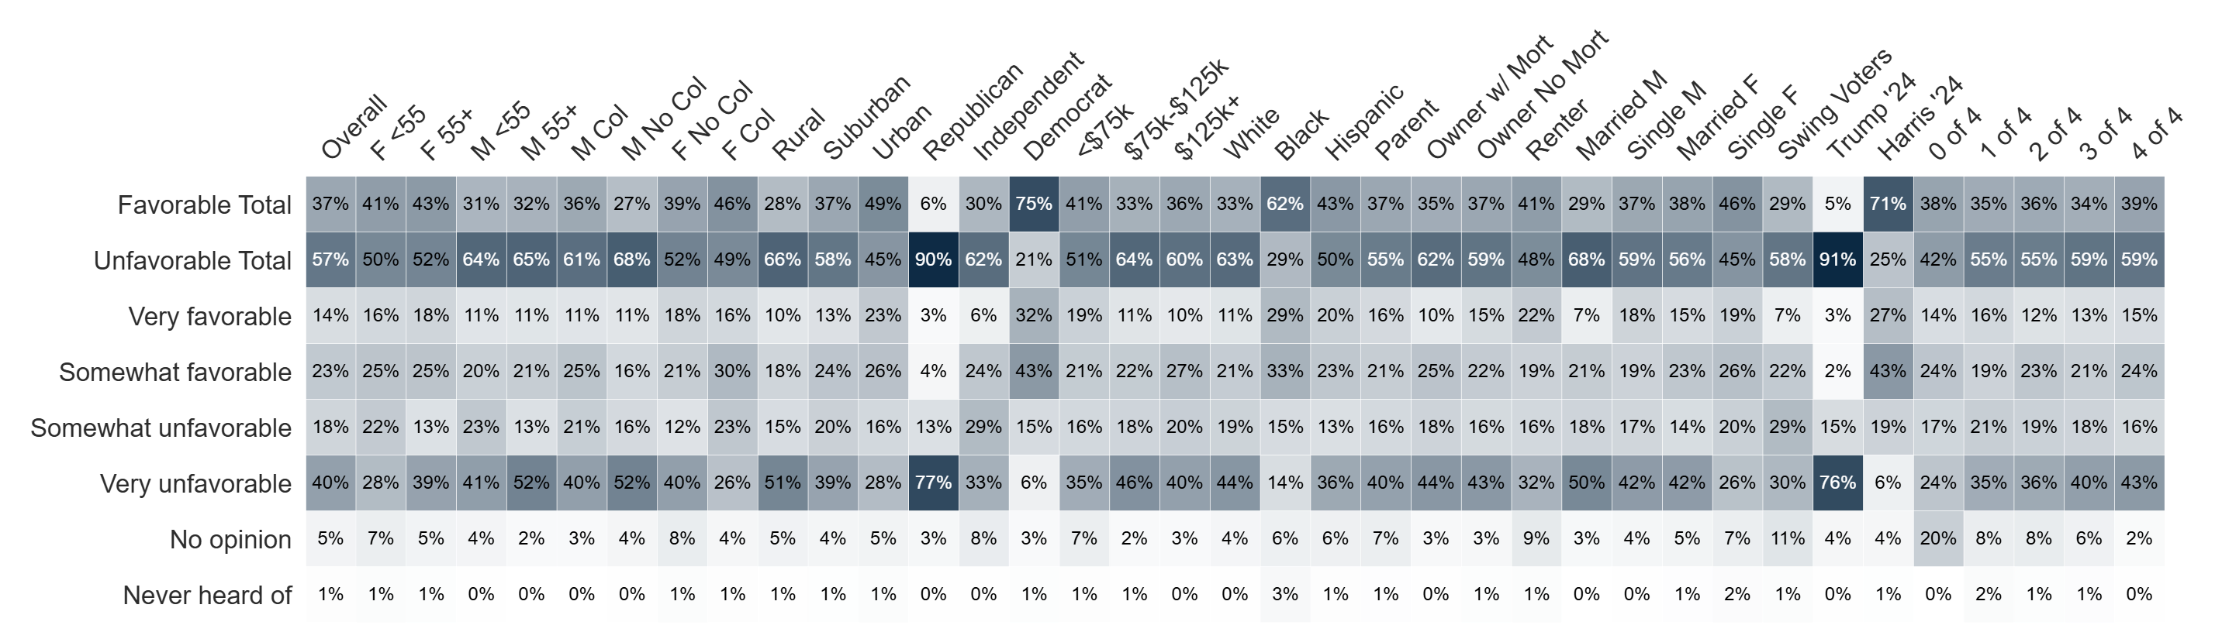
Image: Democrats in Congress
Do you have a favorable or unfavorable opinion of Democrats in Congress?

Slide 41
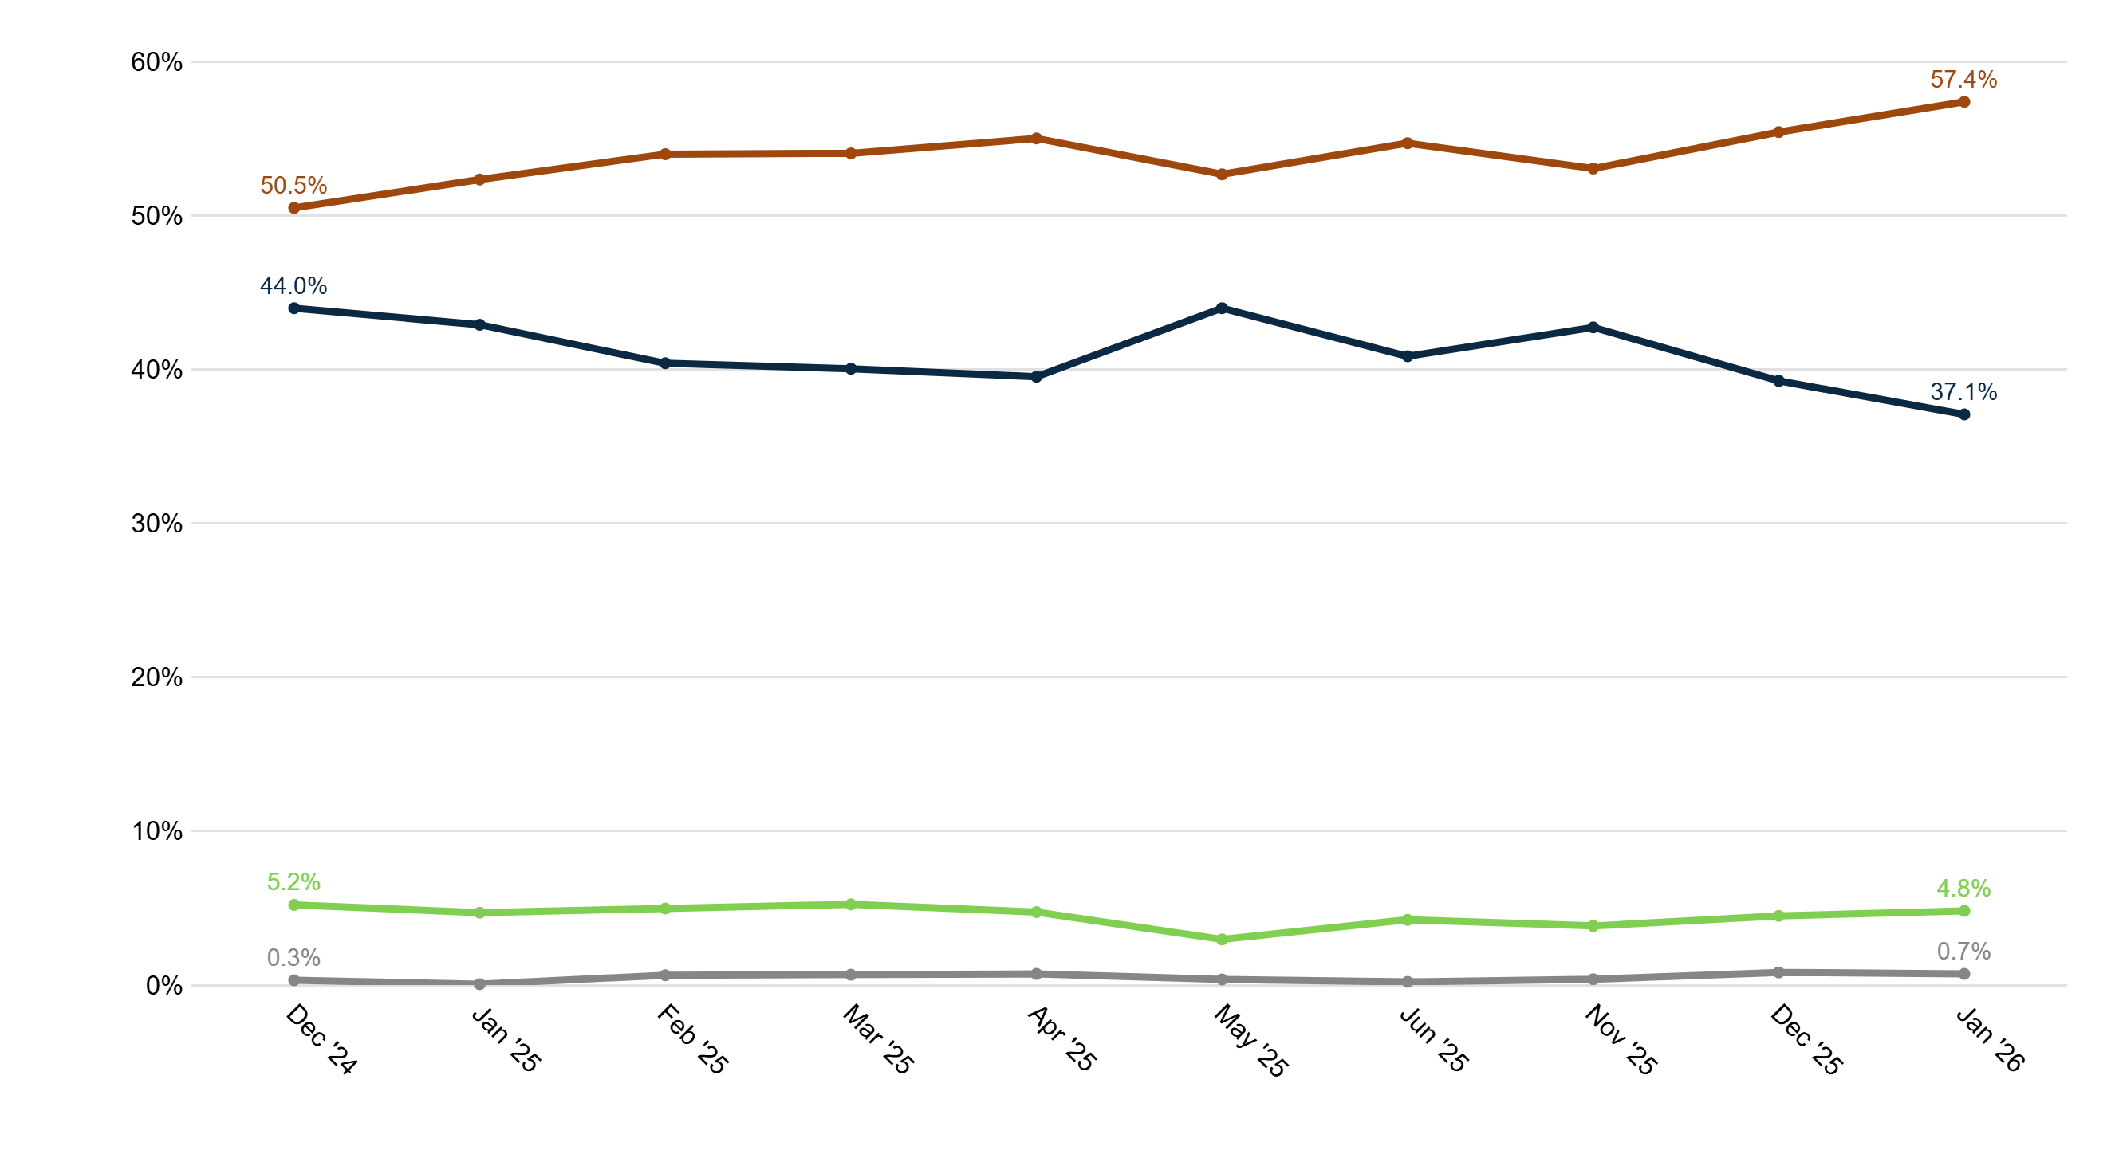
Trend: Democrats in Congress Image
Unfavorable
Favorable
No opinion
Never heard of

Slide 42
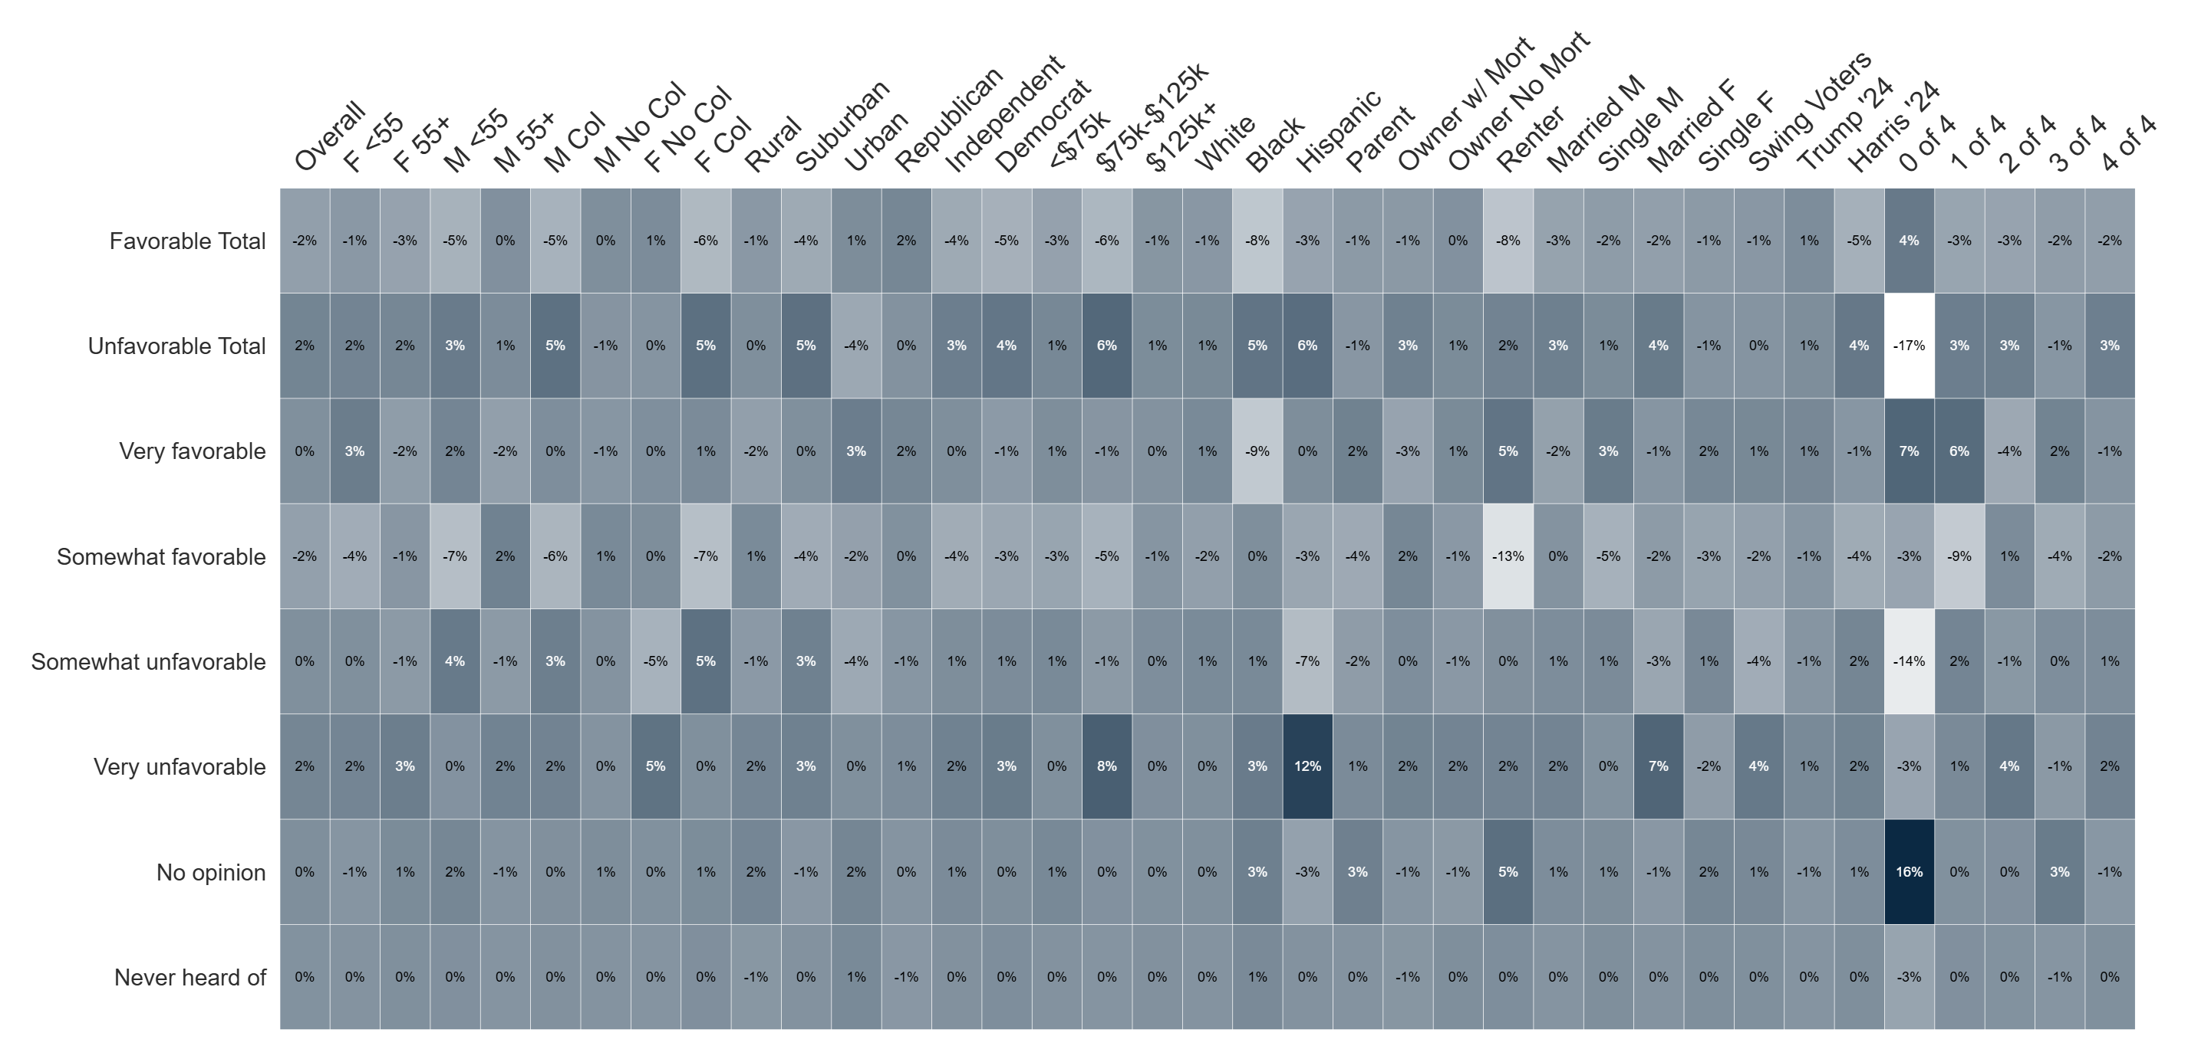
Percent Change: Democrats in Congress Image
(Dec '25 to Jan '26)

Slide 43
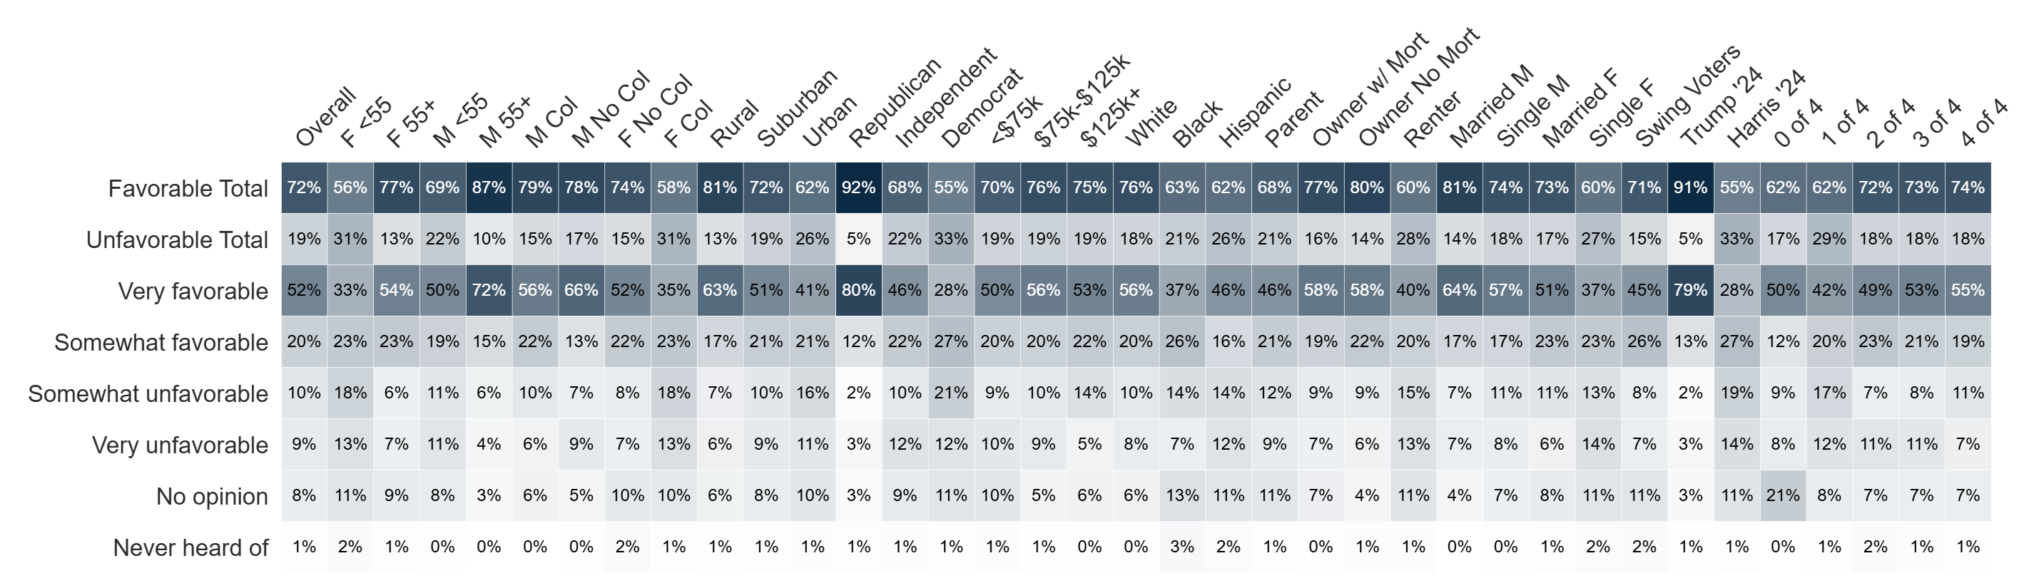
Image: U.S. Military
Do you have a favorable or unfavorable opinion of U.S. Military?

Slide 44
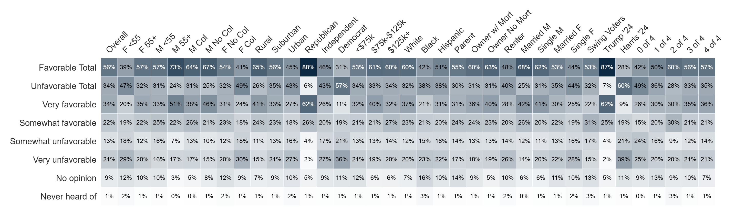
Image: U.S. Military Leadership
Do you have a favorable or unfavorable opinion of U.S. Military leadership?

Slide 45
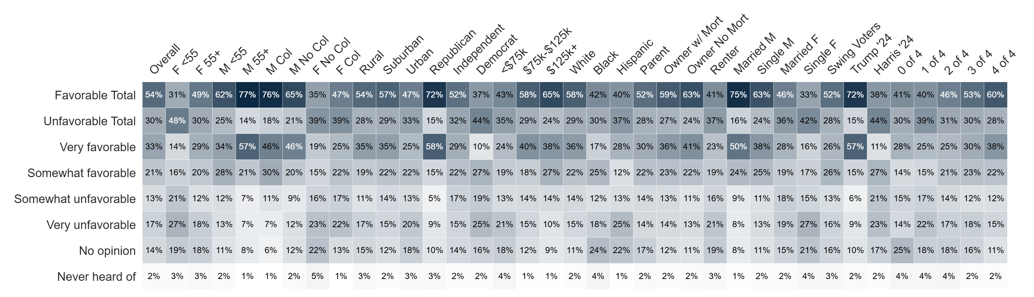
Image: Capitalism
Do you have a favorable or unfavorable opinion of capitalism?

Slide 46
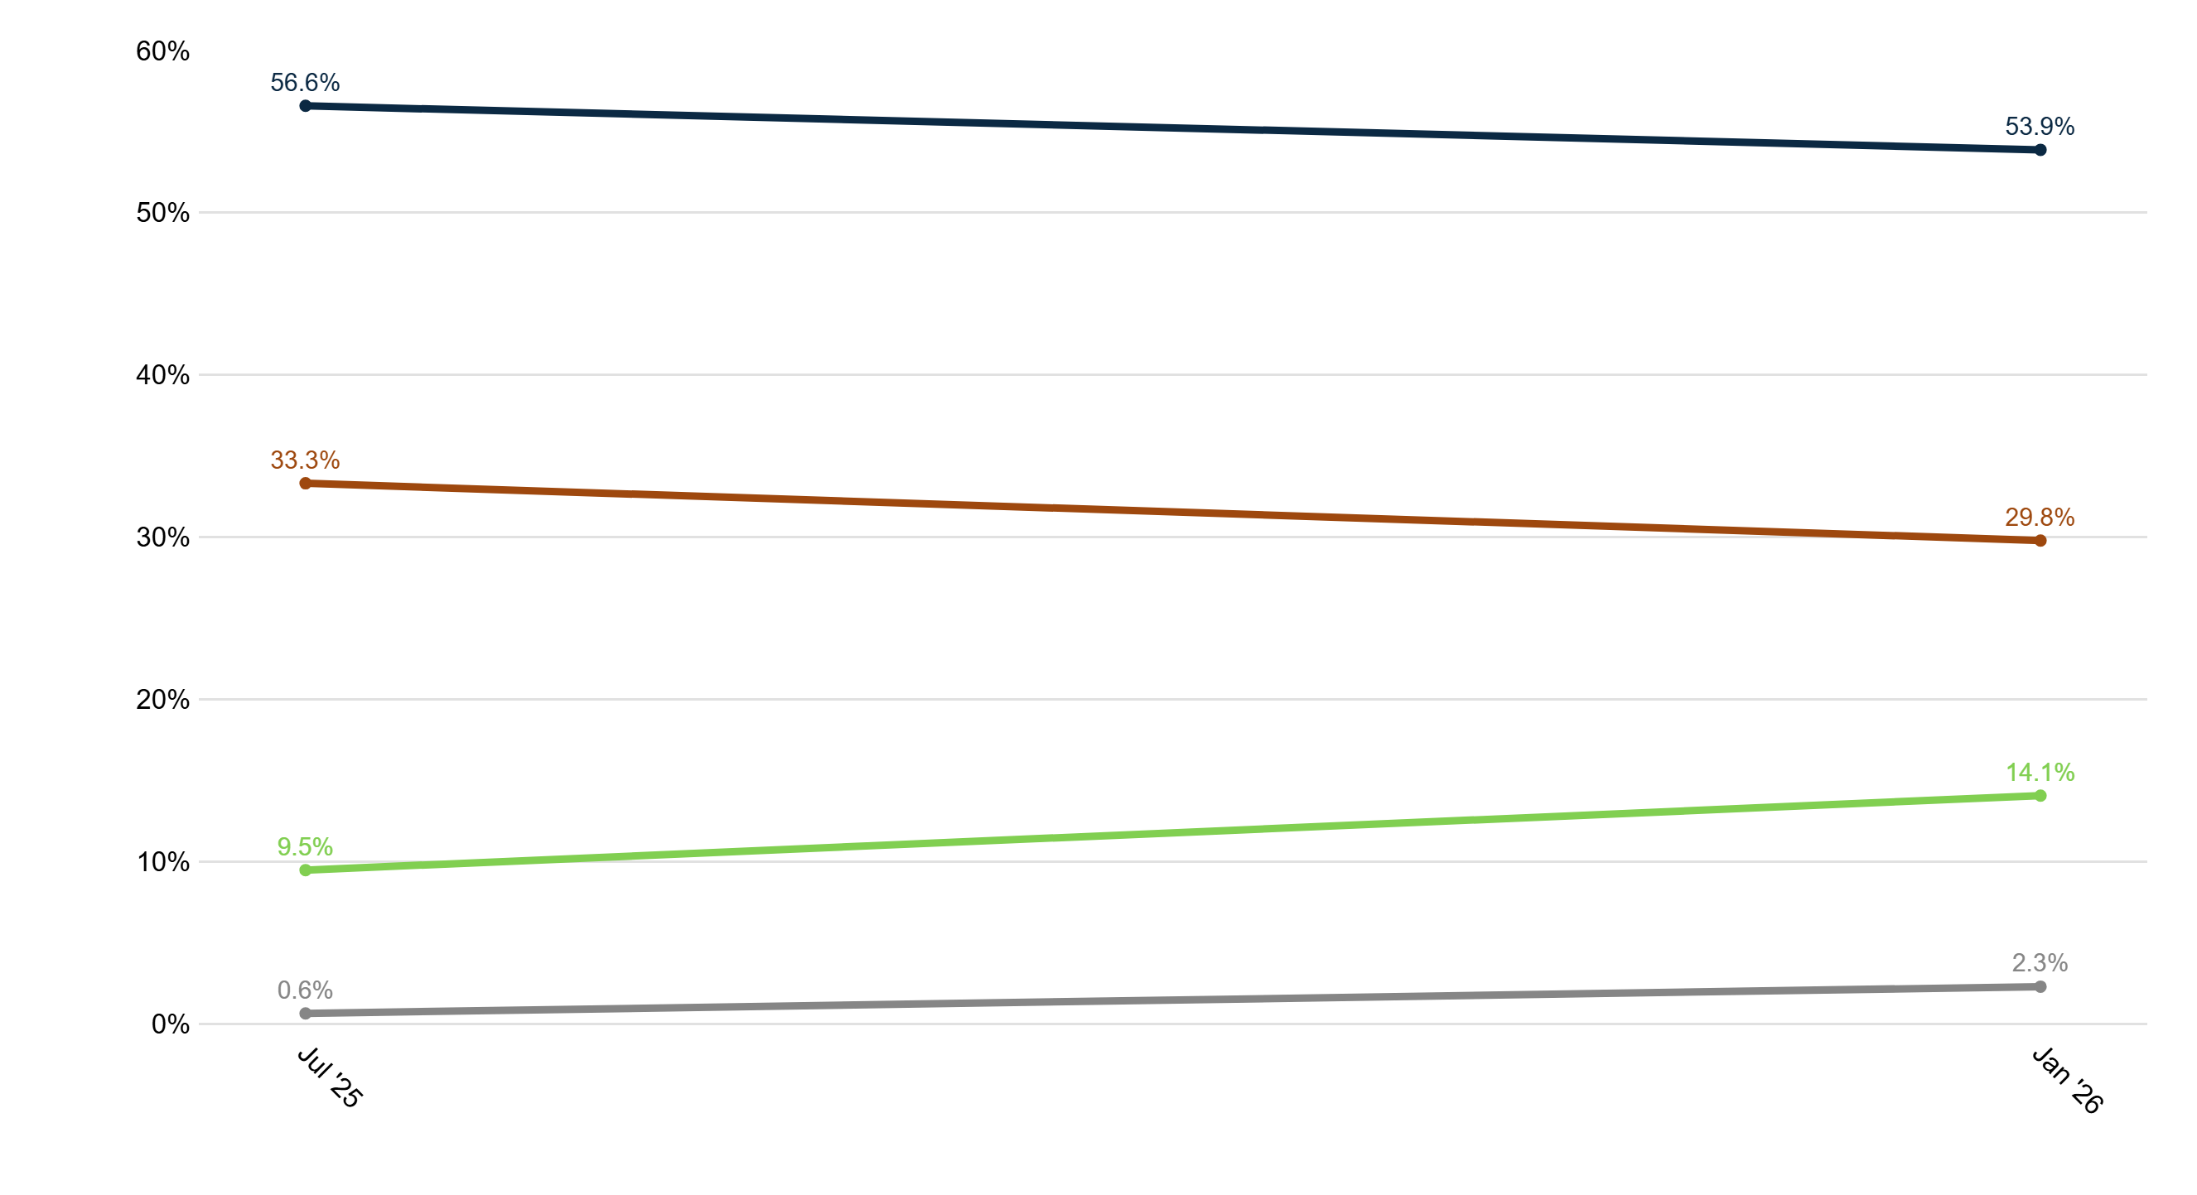
Trend: Capitalism Image
Favorable
Unfavorable
No opinion
Never heard of

Slide 47
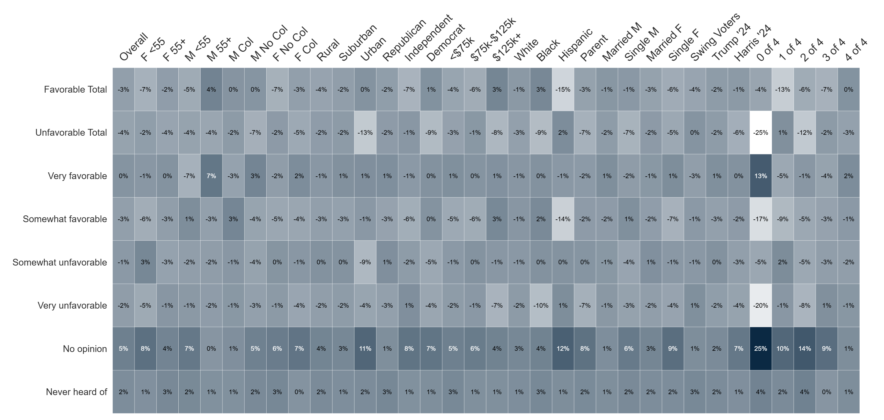
Percent Change: Capitalism Image (Jul '25 to Jan '26)

Slide 48
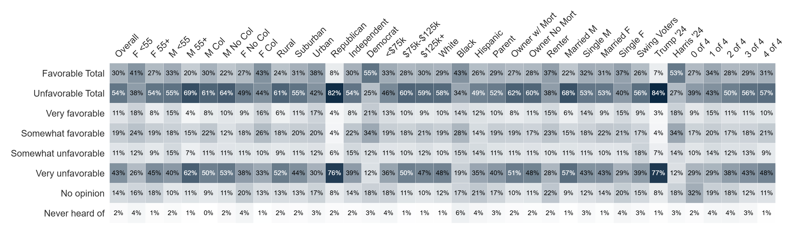
Image: Socialism
Do you have a favorable or unfavorable opinion of socialism?

Slide 49
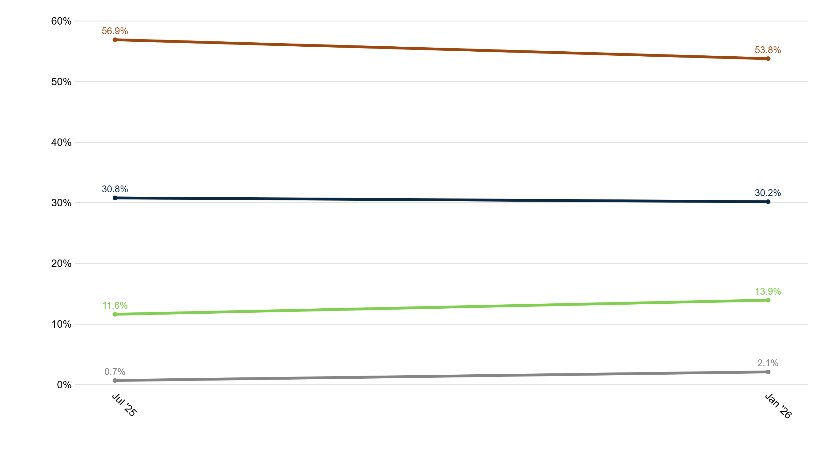
Trend: Socialism Image
Unfavorable
Favorable
No opinion
Never heard of

Slide 50
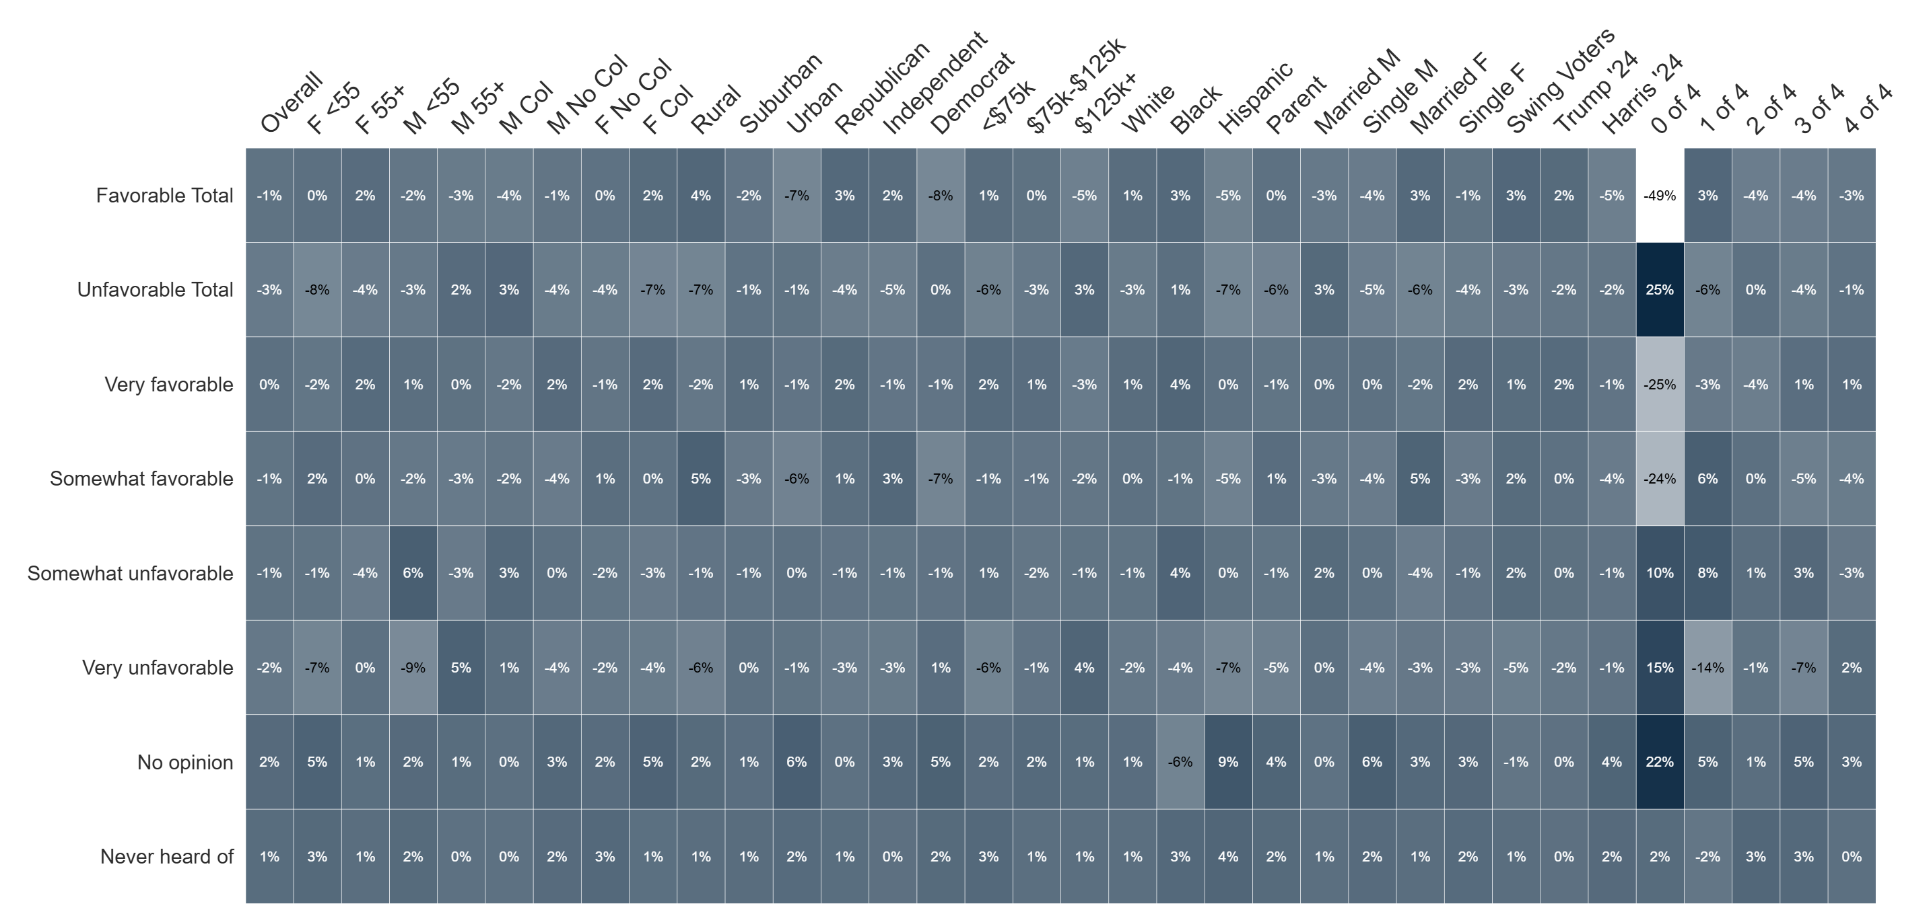
Percent Change: Socialism Image (Jul '25 to Jan '26)

Slide 51
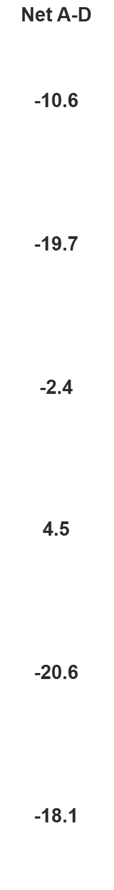
Trump Issue Handling Approval
The following is a list of issues. For each one, indicate if you approve or disapprove of how Donald Trump is handling the topic.

Slide 52
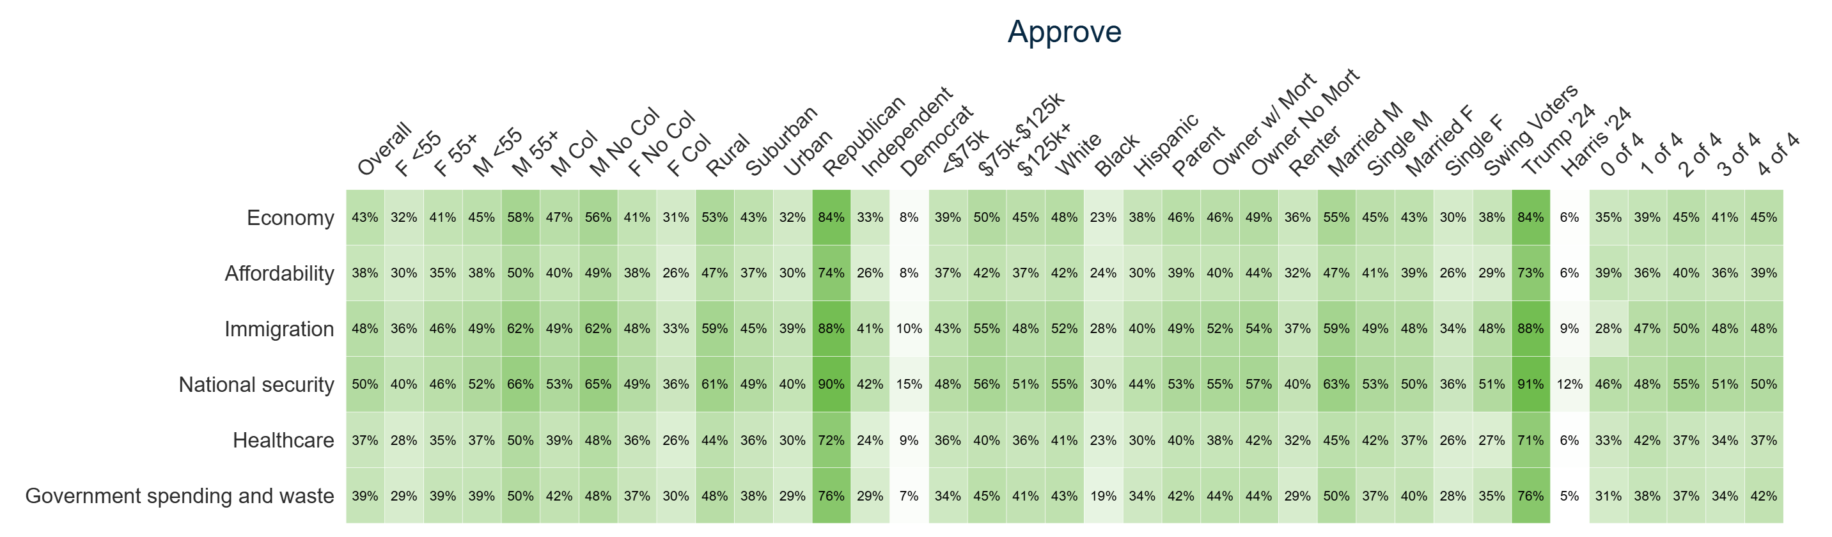
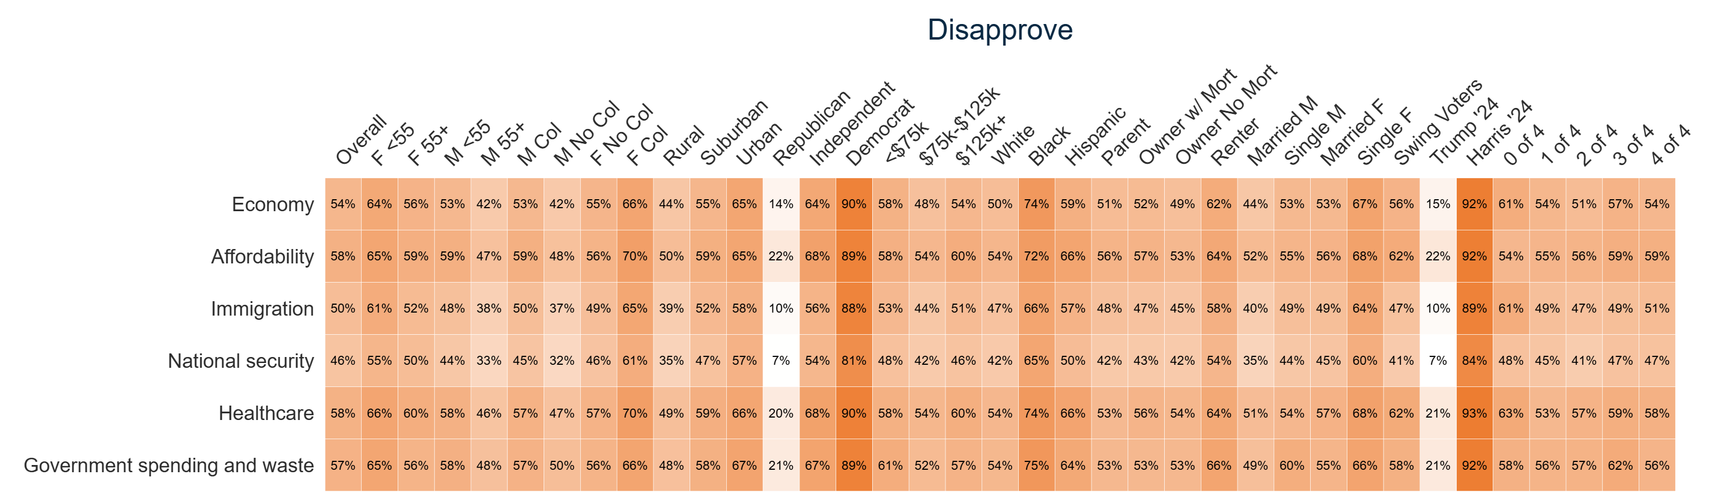
Trump Issue Handling Approval Heatmaps
The following is a list of issues. For each one, indicate if you approve or disapprove of how Donald Trump is handling the topic.

Slide 53

Trump Image – Successes Informed
If you knew that after the first year of President Trump’s second term, illegal border crossings are down 80%, illegal drugs brought by ocean and sea are down 94%, gasoline is now under $2.50 on average, the price of eggs is down 82%, a typical factory or construction worker has seen wages rise by $1,000+, military services members received a $1,776 holiday bonus, taxes on tips, overtime, and social security have been eliminated, and eight peace deals were secured in 10 months, would you have a more favorable or less favorable view of President Trump?

Slide 54

Percent Change: Trump Image – Initial to Successes Informed

Slide 55


2026 Midterm Contrast Ballot
Which of the following results of the November 2026 general elections would you prefer?

Slide 56

Percent Change: 2026 Midterm Contrast Ballot
(Jan '25 to Jan '26)

Slide 57

Expected Midterm Outcome
Regardless of how you plan to vote, do you think Democrats or Republicans will win control of the House of Representatives in November?

Slide 58

Percent Change: Generic Ballot to Expected Midterm Outcome

Slide 59


Affordable Care Act Subsidies Position
In 2021, the Affordable Care Act (Obamacare) was expanded to increase access to subsidized health insurance. That expansion was set to expire in 2025. Congress failed to agree on a budget, causing the longest government shutdown in history, and passed a temporary budget through January 30th while debating whether to continue the subsidies. What do you believe Congress should prioritize?

Slide 60

Percent Change: Affordable Care Act Subsidies Position
(Jan '25 to Jan '26)

Slide 61

Affordable Care Act Subsidies Blame
Who do you blame most for the expiration of the ACA health insurance subsidies?

Slide 62

Higher Health Insurance Costs Handling
If faced with significantly higher health insurance premiums, which of the following would you be most likely to do?

Slide 63

Health Insurance Coverage Source
What is your current source of health insurance coverage?

Slide 64


Assessment of the U.S. Economy
How would you rate the U.S. economy?

Slide 65

Percent Change: Assessment of the U.S. Economy
(Aug '25 to Jan '26)

Slide 66


Assessment of Your Personal Economy
How would you rate your personal economic situation?

Slide 67

Percent Change: Assessment of Your Personal Economy
(Aug '25 to Jan '26)

Slide 68

Job Market Confidence
How confident are you that you could find a comparable or better job within three months if you had to?

Slide 69

Unexpected Expense Confidence
How confident are you that you could financially withstand an unexpected expense of $1,000 or more?

Slide 70

Congressional Economic Priority
Which should be the highest economic priority for Congress in 2026?

Slide 71

Rate Cut Position
This past December, the Federal Reserve cut interest rates for the third time in 2025 by 0.25%. Would you support or oppose further interest rate cuts in 2026 if you knew it could cause inflation to increase?

Slide 72

Mortgage Rate Housing Impact
In January 2025, the average home mortgage rate was around 7%. With current home mortgage rates now near 6.2%, are you more likely or less likely to buy a home in 2026?

Slide 73

Trump Deportation Efforts
Do you think the Trump administration's deportation efforts are going too far, not far enough, or are about right?

Slide 74

Trump Deportation Efforts
Do you believe the Trump administration's immigration policies are making your community safer, less safe, or having no impact?

Slide 75

Deportations Impact on Housing Market
Do you believe the Trump administration's immigration policies are easing pressure on the housing market, adding more pressure, or having no impact?

Slide 76

Venezuela Military Action
As you may know, the United States military conducted strikes in Venezuela and captured President Nicolás Maduro for a U.S. federal indictment on narco terrorism and drug trafficking. Do you approve or disapprove of this action?

Slide 77

Venezuela Temporary Transition
President Trump has said the U.S. will temporarily 'run' Venezuela until a transition to new leadership. Do you support or oppose this?

Slide 78

Venezuela US Goal Preference
Which goal should be the top U.S. priority in Venezuela right now?

Slide 79

Type of Republican Preference
Which of the following best describes the kind of Republican candidate you prefer?

Slide 80

Political Weaponization of Government
Do you believe the federal government has been weaponized against political opponents?

Slide 81

Misinformation Frequency
How often do you encounter news or information that you later found out was false or misleading?

Slide 82

Agreement on Basic Facts
Some people say we're living in an era where Americans can't agree on basic facts. Do you agree or disagree with this statement?

Slide 83

News Attention
How much attention do you pay to news about politics on TV, radio, newspapers, or the Internet?

Slide 84

Trend: News Attention

Slide 85

Percent Change: News Attention (Dec '25 to Jan '26)

Slide 86

News Source
What are your primary sources for news? Select up to three options.

Slide 87

Trend: News Source

Slide 88

Percent Change: News Source (Dec '25 to Jan '26)

Slide 89


Current Housing Status
What is the current status of your housing situation?

Slide 90

Percent Change: Current Housing Status (Dec '25 to Jan '26)

Slide 91
Segmentation Analysis:
Old GOPs (30%) | Old Dems (39%) | Young Dems (13%) | Young GOPs (19%)

Slide 92
Segmentation Analysis:
Old GOPs (30%) | Old Dems (39%) | Young Dems (13%) | Young GOPs (19%)

Slide 93
Segmentation Analysis:
Old GOPs (30%) | Old Dems (39%) | Young Dems (13%) | Young GOPs (19%)

Slide 94
Segmentation Analysis:
Old GOPs (30%) | Old Dems (39%) | Young Dems (13%) | Young GOPs (19%)

Slide 95
Segmentation Analysis:
Old GOPs (30%) | Old Dems (39%) | Young Dems (13%) | Young GOPs (19%)

Slide 96
Segmentation Analysis:
Old GOPs (30%) | Old Dems (39%) | Young Dems (13%) | Young GOPs (19%)

Slide 97
Segmentation Analysis:
Old GOPs (30%) | Old Dems (39%) | Young Dems (13%) | Young GOPs (19%)

Slide 98
Segmentation Analysis:
Old GOPs (30%) | Old Dems (39%) | Young Dems (13%) | Young GOPs (19%)

Slide 99
Segmentation Analysis:
Old GOPs (30%) | Old Dems (39%) | Young Dems (13%) | Young GOPs (19%)

Slide 100
Segmentation Analysis:
Old GOPs (30%) | Old Dems (39%) | Young Dems (13%) | Young GOPs (19%)

Slide 101
Segmentation Analysis:
Old GOPs (30%) | Old Dems (39%) | Young Dems (13%) | Young GOPs (19%)

Slide 102




Demographics
Sex
Age Range
Household Income
53.6% Female
46.4% Male
Geo - Region
Education
Race/Ethnicity
45.5%
have at least
a College degree
53.9% have no college degree
Partisanship
Ideology
Community Type
Total sample size: 1500

Slide 103

Streaming app(s)
TikTok
Facebook
Twitter/ X
YouTube

Slide 104

National TV news
Local TV News
﻿
Cable news
Streaming app(s)
﻿
Social Media
﻿
Newspaper
﻿
Talk radio
﻿
Podcasts

Slide 105


